Slide 1
Improving quality of care and optimizing revenue through data collection and analysis
Ayo Kalejaiye
President and CEO
MedisoftRx
Corona, California, U.S.A.

Slide 2
SQHN 4th. Annual Conference:
1
Company Overview
2
Chronic Disease – Current Situation
3
Where Do We Go From Here?
4
Application Demonstration

Slide 3
MedisoftRX - MANAGEMENT TEAM
Ayo Kalejaiye, Pharm.D., MBA – President and CEO
Steve Bass, M.D. – Chief Medical Director
Dr. Richard Oyekan – Chief Information Officer
Susan Tenorio, R.N. – Director, Population Health

Slide 4
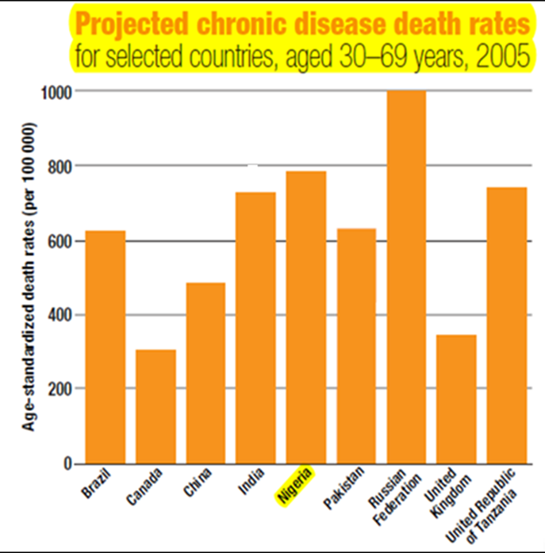
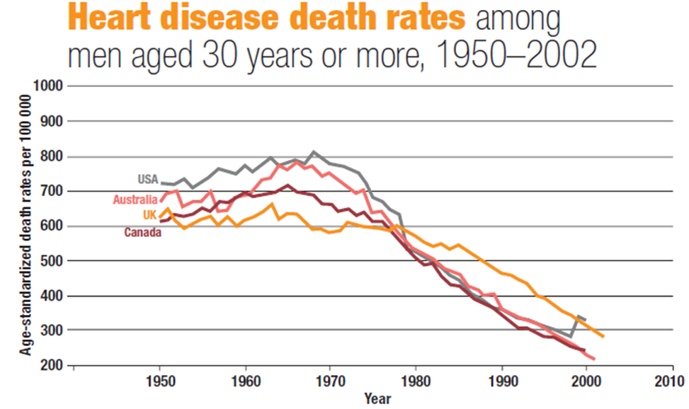
CURRENT SITUATION
1. Cardiovascular and cerebrovascular diseases, diabetes, and cancer are emerging as major public health problems in Nigeria. By 2015, chronic diseases will be a leading cause of death in Nigeria (WHO).

Slide 5
CURRENT SITUATION
2. According to Minister of Health, Prof. Onyebuchi Chukwu, > 500,000 Nigerians die every year from these chronic conditions. 80% of these conditions (e.g. premature heart disease, stroke, diabetes) can be prevented.
3. If not successfully prevented and managed, they will become the most expensive problems faced by our health care systems.

Slide 6
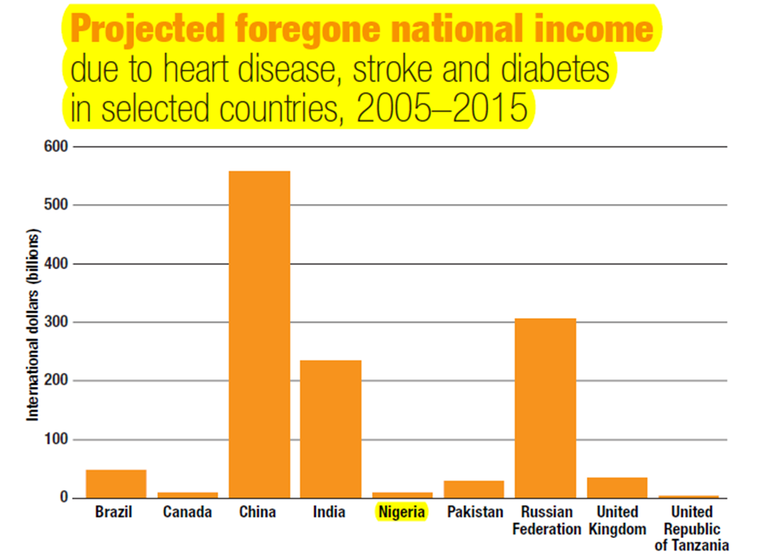
CURRENT SITUATION
4. The wealth of our nation is inextricably linked to the health of her citizens. These preventable, premature deaths are undermining our efforts to increase life expectancy and the economic growth of our country.

Slide 7
WHER DO WE GO FROM HERE?
Traditionally, healthcare has been about sick care. We must take care of the sick, but also take care of the well, and prevent them from becoming sick.
Develop a patient-centric population health management framework.
Allows engagement with the population at every segment of the health continuum.
Understand the demographics, needs & health status of the population.
Proactively deliver age and gender-appropriate evidence-based clinical preventive care.
Deploy evidence-based management of medical and disease conditions.
Continuous evaluation and improvement of processes that impact desired outcome.

Slide 8
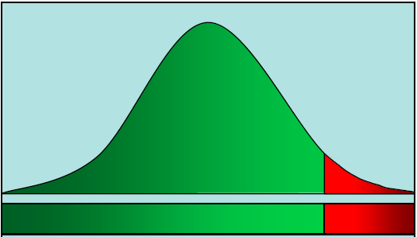
Conceptual Framework: Population Health Continuum
Optimal Health
Good Health – w/varying risk for disease
Chronic Disease
Disease Progression

Slide 9
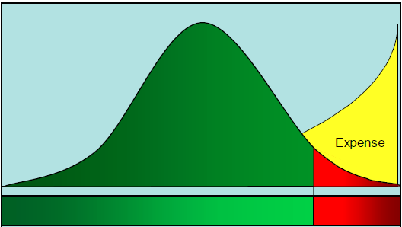
Conceptual Framework: Population Health Continuum
Primary Prevention:
Healthy life Style
Weight Control
Physical activity
Secondary Prevention:
Screen for risk factors
Control risk factors (Cholesterol, HTN, Diabetes, etc).
Tertiary Prevention:
Manage Care Gaps
Manage Risk Factors
Optimal Health
cost of care: $290/yr
Good Health – w/varying risk for disease
cost of care: $1,860/yr
Chronic Disease
cost of care: $7,350/yr

Slide 10
Data Integration
Data
Information
Knowledge
Doctors
Data Sources
Integrated Care
Care Gaps
Wellness Programs
Drug Alerts
Population Health Management
Analytics & Reporting
Education
Nurses
Master Patient Profile
Clinical Rules Engine
Hospital
Clinic
Pharmacists
Pharmacy
Disease Registry
Disease Manage - ment
Laboratory
Patients
Other
Evidence Based Clinical Guidelines
Treatment Guidelines
Predictive Model
Manage - ment
Feedback

Slide 11
APPLICTION DEMO.

Slide 12
Contact:
MedisoftRx
1013 Peter Christian Circle
Corona, CA 92881
+1 951-737-9331
email: info@medisoftrx.com
www.medisoftanalytics.com

