Slide 1
Occupational Safety and Health Risks in Healthcare Systems
Presented By:
Ehi Iden
Chief Executive Officer

Slide 2
Healthcare system defined
“A health system, also sometimes referred to as health care system or healthcare system, is the organization of people, institutions, and resources that deliver health care services to meet the health needs of target populations.” Wikipedia
“A health system is the sum total of all the organizations, institutions and resources whose primary purpose is to improve health. A good health system improves people’s lives tangibly every day” World Health Organisation.

Slide 3
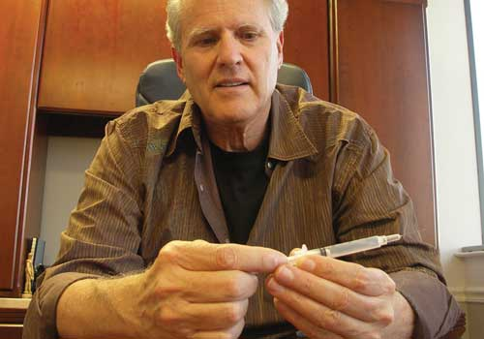
Introduction
The Thomas J. Shaw’s story
(CEO/President) Retractable Technologies founded in 1998.
Manufacturers of Vanish Point syringes
A renowned Design Engineer with multiple patents.

Slide 4

LESSON LEARNT
It does not take exclusively healthcare professionals to solve the Occupational Health and Safety issues within the sector, it needs a multidisciplinary approach.
Attract everyone to partner, pull down the walls
The way out is team-based solution approach

Slide 5
Are healthcare facilities really hazardous?
Other sectors as oil and gas, maritime, mining, construction, agriculture etc. have acknowledged the presence of hazards in their workplaces and they are taking appropriate actions in terms of control.
The hazards in the healthcare sector far outweighs the level of hazards available in some of these sectors

Slide 6
Burden of Infections worldwide
MALARIA
300-500 mil episodes / year
1.5-2.7 mil deaths / year
90 countries at risk worldwide
TUBERCULOSIS
8 mil new infections / year
1.6 mil deaths in 2005
1/3 of the world currently affected
HIV
40 mil patients affected
4 mil new infections / year
2.9 mil deaths in 2006
Most countries affected with different infection rates
HEALTHCARE ASSOCIATED INFECTIONS
Statistics is low because of poor reporting.
But assumed to be more than all 3 infections classes put together.
Global daily infection rate in hospitals only estimated at 1.4 million. “Prof. Didier Pettit (UNIVERSITY OF GENEVA)”

Slide 7
General concern
1.4 million infections rate each day in hospitals only across the world
This cuts across both healthcare workers and patients alike
Burden of disease outside hospitals is unknown
No hospital, no country, no health-care system in the world can claim to have solved the problem but everyone is working on something.
CDC reports says healthcare is still the fastest-growing sector of the U.S. economy, employing over 18 million workers while women represent nearly 80% of the healthcare work force.

Slide 8
The WHO Position
A health care facility is a workplace as well as a place for receiving and giving care. Healthcare facilities around the world employ over 59 million workers who are exposed to a complex variety of health and safety hazards everyday. The risks span from:
Biological hazards, such as TB, Hepatitis, HIV/AIDS, SARS and other infections
Chemical hazards, such as, ethylene oxide, latex allergy
Physical hazards, such as noise, radiation, slips trips, falls and needle sticks injuries
Ergonomic hazards, such as, poor work environment conditions, heavy lifting and back aches
Psychosocial hazards, such as shift work, workplace violence, needle stick injuries and stress
Fire and explosion hazards, such as using oxygen, alcohol sanitizing gels etc.
Electrical hazards, such as frayed electrical cords, overloading, naked wires etc.

Slide 9
Where are these risks within our system?
They are every where, from the bedside to the boardroom, more exposed areas include:
Doctors consulting rooms
Injection rooms
Operating theatres
Delivery rooms
Laboratories/phlebotomy
Radiography units
Admission rooms and wards
Ambulance transportation
Laundry units
Cleaners’ exposure
Frontline engagements

Slide 10
Global Shortage of Healthcare workers
The 2006 World Health Report “Working Together for Health” on human resources reported a global shortage of health personnel which had reached crisis level in 57 countries. And called for the support and protection of the health workforce.
11 NOVEMBER 2013 | RECIFE, BRAZIL - WHO declared that the world will be short of 12.9 million health-care workers by 2035; today, that figure stands at 7.2 million. The report warns that the findings – if not addressed now – will have serious implications for the health of billions of people across all regions of the world.
Sub Sahara Africa region has been predicted to suffer an ACUTE shortage of healthcare workers

Slide 11

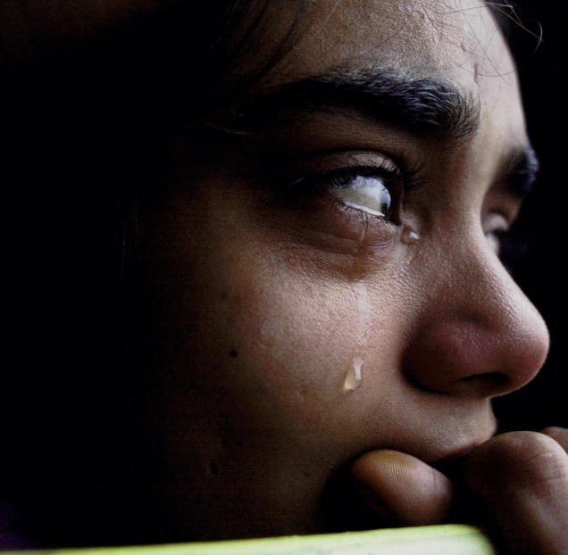
What really has gone wrong???
Safety Brings Cheers
Accident Brings Tears

Slide 12

General Perceptions
The statements in most healthcare systems have not shown our healthcare employees how much we care about their health and safety
What is most times perceived is profit driven above health and safety in our body language
Trust is in question?????
The hazards are enormous and we are not discussing them. Employees want to talk yet no one wants to listen

Slide 13
EVENTUAL RESULT
A workplace becomes unattractive when characterised with uncontrolled overwhelming risks that we do nothing about
No one feels safe outside honest and enforceable policies with clear leadership commitment, we do not walk our talk
Where there are no laws, there are no offences
Consider the SAD concept
Encourage a safety culture which must start from the TOP
Leadership responsibility in terms of work environment and work style modification

Slide 14
ARE THERE SOLUTIONS WITHIN?
NEEDLE STICKS INJURIES
The universal precaution is implementation of hierarchy of control through:
Elimination: Through changes in how medications are given.
Engineering control: Redesign with shield and sheaths
Substitution: Use of safe alternatives
Administrative control: Modification of hazardous workplace, quick removal of filled sharps and disposal boxes, safety education and awareness and feedbacks.
Personal protective equipment (PPE): Use of safety shoes instead of open sandals

Slide 15
Review of some studies ON NEEDLE STICKS
Some studies have shown that needleless or protected-needle IV systems decreased needle stick injuries related to IV connectors by 62% to 88%.
In a CDC study, phlebotomy injuries (i.e., those involving the letting of blood) were reduced by 76% with a self-blunting needle, 66% with a hinged needle shield and 23% with a sliding-shield, winged-steel (butterfly-type) needle.
Another study concluded that phlebotomy injuries were reduced by 82% with a needle shield, but a recapping device had minimal impact in reduction of injuries.
Other research concluded that safer IV catheters that encase the needle after use reduced needle stick injuries related to IV insertion by 83% in three hospitals study.

Slide 16
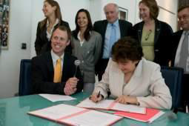

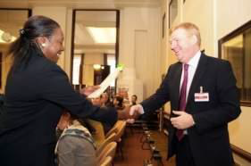
ARE THERE SOLUTIONS WITHIN…….
HAND HYGIENE: Clean hands reduce the burden of disease. Clean hands save lives
Hand washing with soap and water or alcohol hand rub critical in reducing infections in healthcare
This also has a challenge of compliance, time constraint is the major obstacle of hand hygiene. Compliance less than 40%.
An average of 22 opportunities per hour for an ICU Nurse (soap + water 1-1.5 minutes, alcohol-based hand rub 15 – 20 seconds)
Legislation and political commitment also needed

Slide 17
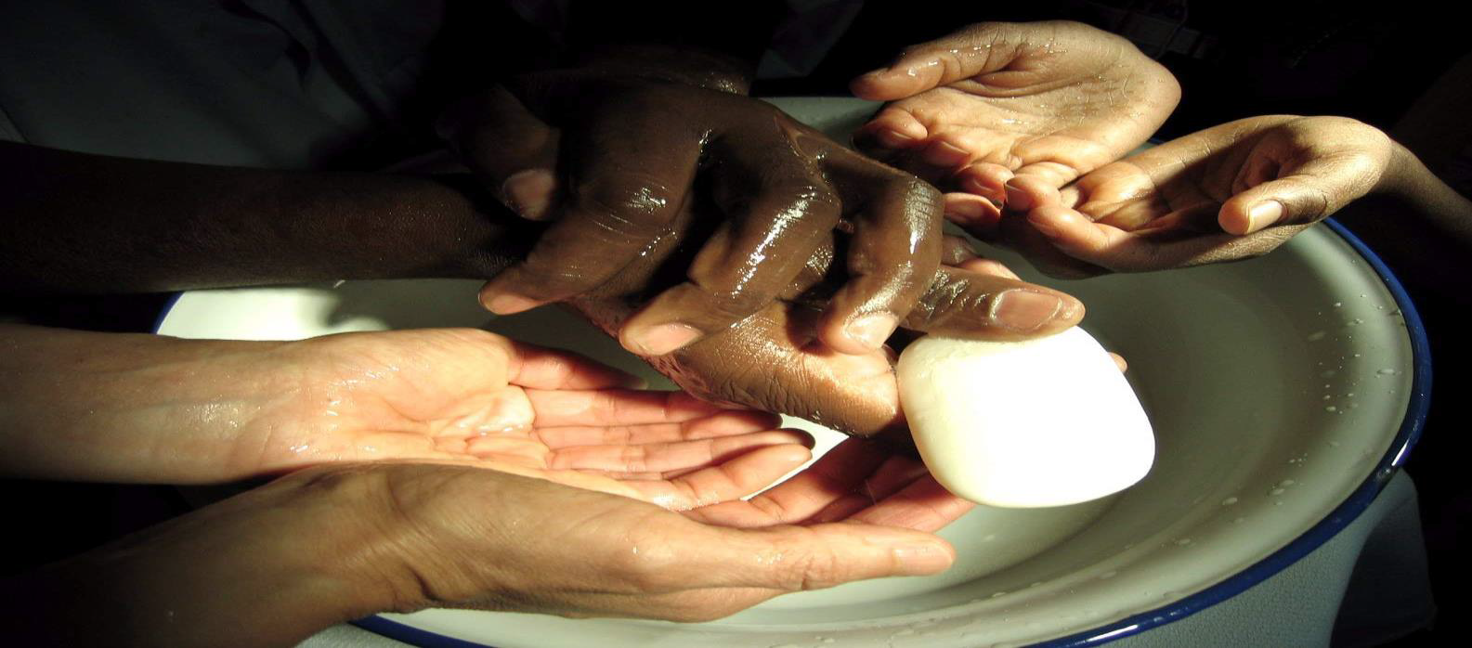
Clean hands save lives

Slide 18
Hand hygiene
This is the most effective prevention of healthcare acquired infections
Discovered in mid 19th century by Ignaz Semmelweis, an Obstetrician in University of Vienna. The delivery of women in two wards concept and Puerperal fever/autopsies
In hospitals, hands get infected with micro organism when touching patients or contaminated surfaces
Education, training in hand hygiene and also reminder sign are good interventions
In good hand hygiene practice, you wear no rings or wrist watches or keep grown nails
Presence of clean running water, liquid soap, wash hand basins and paper towels at POC
Alcohol hand run mounted on walls or bed racks
Comparison: Studies have shown washing with soap and water reduces bacteria 1,000 times while alcohol hand rub reduces contamination by a factor of 10,000 – 100,000
Washing with water removes organic matter better than alcohol hand rub
Alcohol hand run contains emollients like glycerol which prevents drying of the skin while washing with soap and water can cause dry skin
Washing with soap and water takes more time than alcohol hand rub

Slide 19
WHO 5 MOMENTS FOR HAND HYGIENE
Before touching a patient
Before clean/aseptic procedure
After body fluid exposure risk
After touching a patient
After touching patient surrounding

Slide 20
WHO INSTRUCTIONS ON HAND WASHING
Wet hands with water
Apply enough soap to cover all surfaces
Rub hands palm to palm
Right palm over left dorsum with interlaced fingers and vice versa
Palm to palm with fingers interlaced
Backs of fingers to opposing palms with fingers interlocked
Rotational rubbing of left thumb clasped in right palm and vice versa
Rotational rubbing, backwards and forwards with clasped fingers of right hand in left palm and vice versa
Rinse hands with water
Dry hands thoroughly with a single use towel
Use towel to turn off faucet
Your hands are now safe

Slide 21
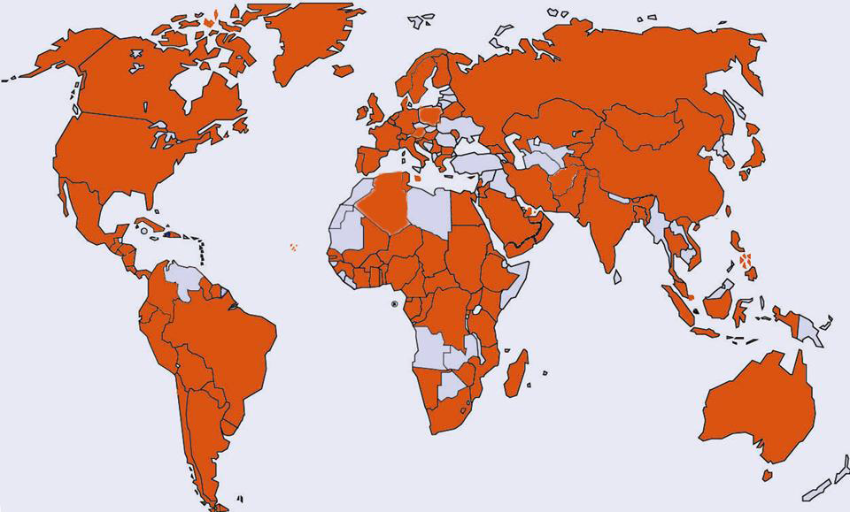
133 countries committed to address health care-associated infection World population coverage: 94.5%. OCT 2005 – JUNE 2013

Slide 22
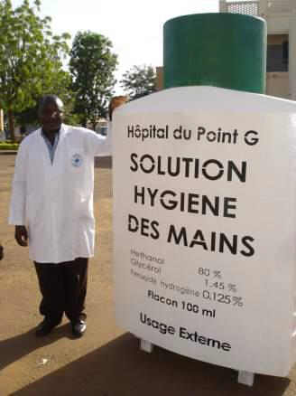
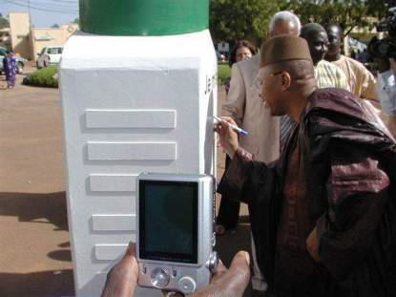
A Pharmacist’s invention in Mali and the FMOH endorsement 2007

Slide 23
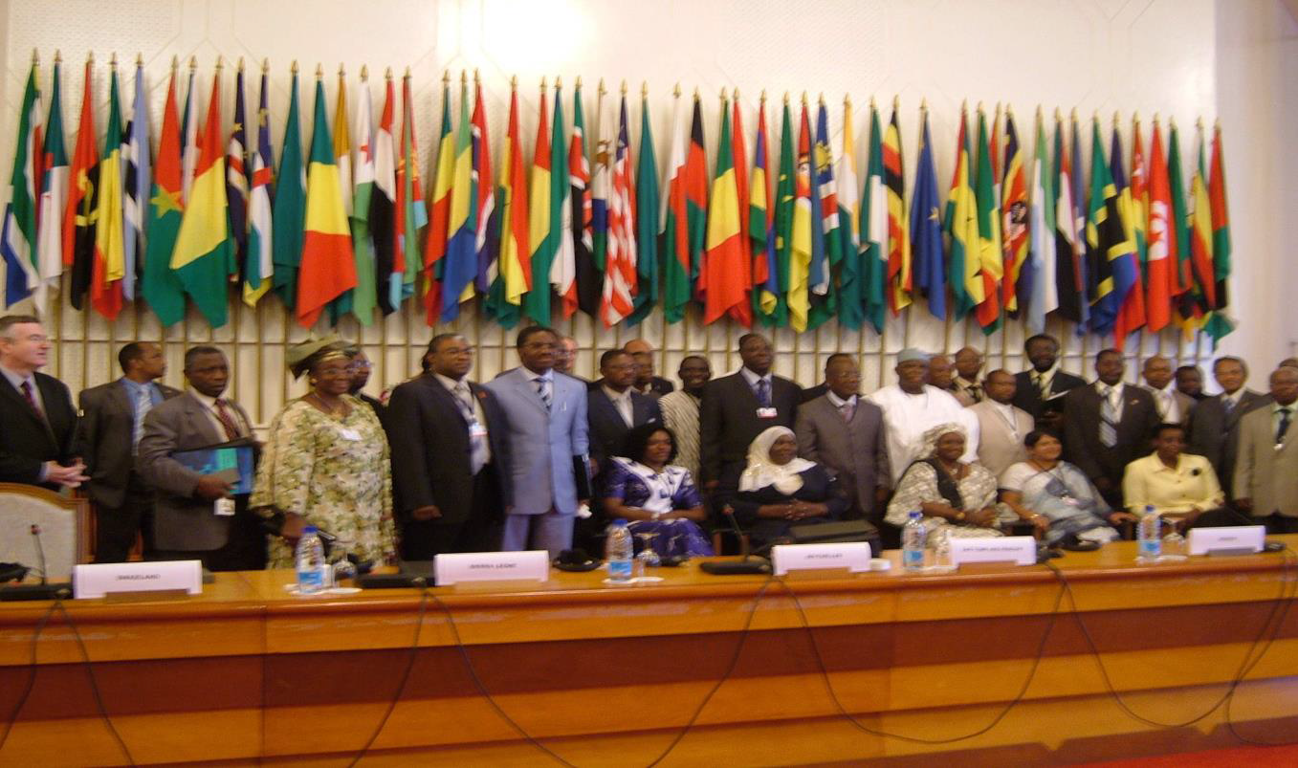
Pledges of the Ministries of Health of 27 African countries to Clean Care is Safer Care, Assembly of the MoH, Africa, Yaoundé, Cameroun, 2008

Slide 24
HOW CAN WE uphold THIS IN OUR FACILITIES
Strong leadership commitment
Purposeful policy formulation and implementation
The Three policy imperatives include:
Policy for social imperatives: We are saying must save lives, do what ever it takes, health and safety is our culture. It is system driven in utmost honesty.
Policy for fiscal imperatives: We must save money at all cost, we must do all it takes to make it happen.
Policy for legal imperatives: We must stay out of trouble, do only what we must do to avoid consequences.

Slide 25
Deploy The 5 STARS Leadership Concept
Supervision: Overseeing work activities and ensuring workers are safe
Training: Conducting health & safety education and training
Accountability: Insisting everyone complies with company’s health and safety policies and rules
Resources: Providing physical resources as tools, equipment, materials etc. and human resources as enough man-power to sustain the system and processes
Support: Creating psychological environment, schedule, workload, recognition etc.

Slide 26
Create a health and safety culture
When Health and Safety is part of your culture it can never hide itself.
Health and Safety begins at recruitment unto retirement
Culture induction program for new employees
Encourage incident reporting and endeavour to act on these reports
Trust no safety processes to assumption, educate, train, review and retrain
Corporate culture is better than common sense

Slide 27
Keys to Creating health & Safety Culture
Define Roles and Responsibilities – Communicate organizational goals to everyone, define their roles, get their words and commitment.
Hold Everyone Accountable – The need to fulfill a task to a set standard. When you are accountable, your performance is measured against some specific criteria, consequences are applied appropriately to the level of quality of performance.
Communicate – Let people know how the organization is doing as a TEAM. How safety is impacting on productivity, whether positive or negative basis. Ask for input to determine what can be done better or differently. Keep people in the loop so they feel like they are part of the process.

Slide 28
Safety Accountability
Effective safety accountability across all levels
Accountability must start from the top and feedback or effects must be seen going back from bottom to top
An established standard to measure performance
Resources to achieve those standards
A system or template of measurement must be collective agreed on
Appropriate application of effective consequences - meeting or exceeding standards or failing to meet standards

Slide 29
Conflict of Interest
Profitability and Safety or profitability vs. Safety
Allowing employees to use unsafe practices in order to meet their production goals
In this culture, when job security is on the line, working fast will take priority over working safe.
In a world-class safety culture, job security depends on working safe, not working fast. We need to change this.

Slide 30
Leadership Reward & Consequence
The more you reward a behavior the more frequently such behaviour is repeated. Example with J.F Skinner Theory
There are two ways to change behavior.
Do something before the behavior occurs
Do something after the behavior occurs
In the science of behavior analysis, the technical word for what comes before a behavior is antecedent. The word for what comes after a behavior is consequence. Aubrey Daniels “Bringing Out the Best in People”

Slide 31
The Two Types of Reward System
Reward does not necessarily mean cash disbursement, it is a very cost effective way of motivating employees
Extrinsic reward: Tangible and external
Intrinsic reward: Intangible and internal
Make people feel good when they do the right thing
Create health and safety awards and recognition badges
Create recognition courses, framed photographs, redeemable vouchers, meal tickets, safety heroes and champions etc.

Slide 32
Points to Note
Workplace Health and Safety will amount to nothing if there is no commitment from top
The concept is about TTB-BTT communication
Allow no vacuum at both ends mostly at the top
Leaderships are held responsible for the success and failure of health and safety in their workplaces
Safety is a management position, cast it not far down the ladder of hierarchy
But we can actually use this to our advantage as leaders

Slide 33
In Conclusion
He that craves for safety must think SAFE
Spot the hazards
Assess the risk
Find safer ways
Every day
“Salus Populi Suprema Lex”

Slide 34
References
Emerging trends in global health: Infectious diseases Healthcare-Associated Infection Prevention: Pushing Back Barriers and National Frontiers. Prof. Didier Pittet, Department of Internal Medicine Specialties, Faculty of Medicine, University of Geneva
Hand Hygiene in Healthcare, by Olov Aspevall, Clinical Bacteriologist and Infection Control Physician, Senior Consultant Public Health Agency, Sweden
Sax H, Allegranzi B, Uçkay I, Larson E, Boyce J, Pittet D. J Hosp Infect 2007;67:9-21
http://www.nejm.org/doi/full/10.1056/NEJMvcm0903599
http://www.who.int/features/qa/28/en/

Slide 35

ehi@ohsm.com.ng
0802 491 8800

