Slide 1
Hospital acquired Infections:
THE EBOLA VIRUS IN THE HOSPITALS
FADEYI, ABAYOMI
B.Sc, MB,BS, FMC Path
November, 2014

Slide 2
Hospital acquired infections? ( www.who.int/gpsc/country_work/burden, 2011)
INFECTIONS
Originating in an hospital/health-care facility
Consequent upon contact with healthcare
Not present or incubating at the time of contact (admission!)
May be manifesting after contact (discharge!)

Slide 3
Hospital acquired infections?
CLASSIFICATION
1. Occupational or Non-occupational
(www.who.int/gpsc/country_work/burden, 2011)
2. Procedure or Non-procedure specific www.who.int/gpsc/country_work/burden, 2011)
3. Localised or Systemic (Monina Klevens et in Public Health Rep., 2007)
4. Toxigenic or Non-toxigenic (Monina Klevens et al in Public Health Rep., 2007)
5. Opportunistic or Non-opportunistic

Slide 4
Hospital acquired infections?
OTHER NAMES
1. Hospital infections
2. Nosocomial infections
3. Health Care Associated Infections (HCAI)

Slide 5
Risk Groups?
Patients
Patients Relatives
Hospital Staff
Clinical
Administrative
Visitors

Slide 6
CHAIN OF INFECTION (http://assets.cambridge.org/97805216/87010/excerpt/9780521687010_excerpt.pdf)
Notes:
Figure showing chain of infection. An infection can occur only if the six
components shown here are present. Removing any one link breaks the chain and
prevents infection. Of the six links in the chain of infection, the mode of transmission is the easiest link
to break and is key to control of cross-infection in hospitals.

Slide 7
How is HCAI Transmitted?
Contact
Direct (hands of health care personnel)
Indirect
Droplet
large particle droplets (> 5 microns) generated during coughing, sneezing, talking or tracheal suctioning,
pneumonias, pertussis, diphtheria, influenza type B, mumps, and meningitis
Airborne
Evaporated droplet <5 micron, remain suspended in the air for long periods of time
Pulmonary tuberculosis (TB), measles, chicken pox, pulmonary plague and haemorrhagic fever with pneumonia
Common vehicle transmission
food, water, devices, equipment

Slide 8
Transmission by Direct Contact
HAVE YOU DONE THIS TODAY?

Slide 9
Air borne transmission (http://en.wikipedia.org/wiki/Sneeze)

Slide 10
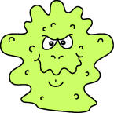
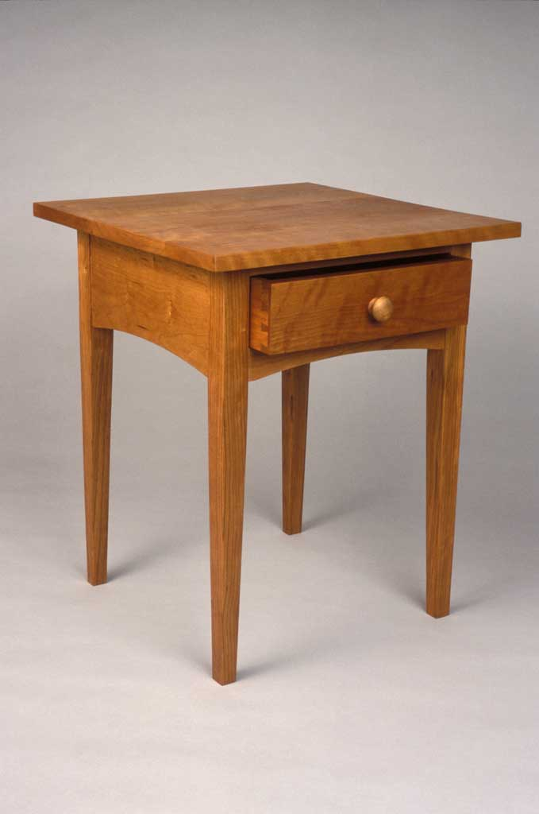
Indirect Spread by Droplets
Droplets with the infectious
agent land on a table,
doorknob etc.

Slide 11
Indirect Spread by Droplets
Someone touches contaminated object

Slide 12
the Indirect Route of Transmission of agents of HCAI
Hospital Environment, Common Hospital Surfaces
Doctors’ white coats, Ties
Nurses’ uniforms
Hospital garments
Privacy drapes
Stethoscopes
Thermometer
Bed rails
Patient care devices, Equipment
Trolleys
Tables

Slide 13
agents of HCAI? (WHO SEARO Regional Publication No. 41, 2011)
MRSA, VRSA, VISA
MDRSP, VRE
MDR- GNB
ESBL producing gram negative bacteria
Stenotrophomonas maltophilia
Acinetobacter spp
MDR-TB
HBV
HCV
HIV
EBOLA VIRUS
Notes:
MRSA: Fadeyi et al, 2010

Slide 14
Sources of the agents of HCAI
Human reservoirs
Patients
Healthcare personnel
Household members
Other visitors
Clinical Status of Human Reservoirs
Active infection
Asymptomatic
Incubation period
Transiently colonized
Chronically colonized

Slide 15
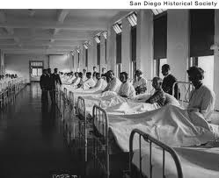

Slide 16
the Burden of HCAI? (WHO/Patient Safety/ save lives, 2011)
Developed Countries
National Prevalence: 5.1%-11.6%
12/100 patients
UTI - most frequent

Slide 17
the Burden of HCAI? (WHO/Patient Safety/ save lives, 2011)
Developing countries
Hospital-wide Prevalence: 5%-19%
20 /100 patients
Surgical Site Infection most common
(1/3 of operated patients)

Slide 18
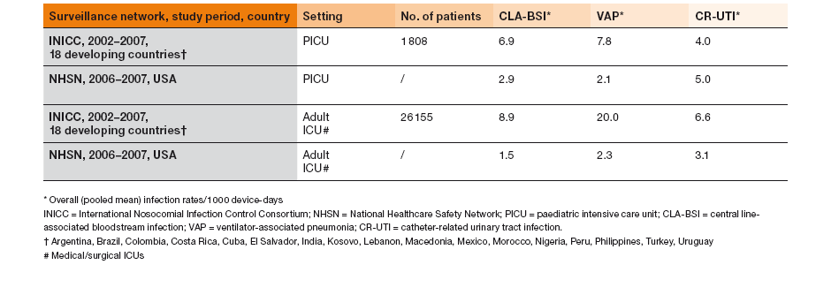
the Burden of HCAI? (WHO/Patient Safety/ save lives, 2011)
More Studied HCAI
CLA-BSI
VAP
CR-UTI
Adult & Neonatal ICU Associated Infections
Higher rates in ICU (Adult & Neonatal)

Slide 19
the impact of HCAI? (WHO/Patient Safety/ save lives, 2011)
Prolonged hospital stay
Long term disability
Increased resistance of microorganisms to antimicrobials
Massive additional financial burden for health system
High cost for patients & their family
Unnecessary deaths

Slide 20
the impact of HCAI? (WHO/Patient Safety/ save lives, 2011)
Europe
16 x 10⁶ extra days of hospital stay
37 000 deaths
7 billion pounds
United State
99 000 deaths
6.5 billion dollars
Developing Countries
?

Slide 21
Risk Factors for hcai (http://www.who.int/gpsc/country_work/gpsc_ccisc_fact_sheet_en.pdf)
Prolonged and inappropriate use of invasive devices and antibiotics;
High-risk and sophisticated procedures;
Immuno-suppression and other severe underlying patient conditions;
Insufficient application of standard and isolation precautions
Inadequate environmental hygienic conditions and waste disposal;

Slide 22
Risk Factors for hcai (http://www.who.int/gpsc/country_work/gpsc_ccisc_fact_sheet_en.pdf)
Poor infrastructure;
Insufficient equipment;
Understaffing;
Overcrowding;
Poor knowledge and application of basic infection control measures;
Lack of procedure;
Lack of knowledge of injection and blood transfusion safety;
Absence of local and national guidelines and policies.

Slide 23
CONTROL:
Break the Chain of Infection!

Slide 24
HCAI Control?
All activities within any hospital setting to ensure that:
1. The infected
do not transmit their pathogen
do not acquire new pathogen
2. Carriers of Potential Pathogen
do not transmit their pathogen
do not acquire new pathogen
3. Uninfected/None-carriers
do not acquire any pathogen

Slide 25
Approach to HCAI Control (WHO SEARO Regional Publication No. 41, 2011)
Infection control Unit
(HEAD-Chief Executive)
Infection Control Committee
(HEAD-Infectious Dxs Physician)
Infection Control Team
(HEAD-Nurse)
Policies & Principles
Infection control policy statement (Procedural)
Infection control manual
Structural Organization (Infection Control Unit)
Chief Executive
Establish an infection control committee
Provide adequate resources
Infection control committee
Infection control Team
Affiliates
Microbiology (Lab), Nursing Dept, Epidemiologist, Works Dept (Engr), Computer Unit, Infectious Diseases Physicians etc

Slide 26
Five pillars of infection control (http://assets.cambridge.org/97805216/87010/excerpt/9780521687010_excerpt.pdf)

Slide 27
Practical HCAI Control measures (WHO SEARO Regional Publication No. 41, 2011)
Basic Measures for Infection Control
Standard precautions
Additional precautions (airborne, droplet and contact)
Education and Training of Health Care Workers
Protection of Health Care Workers, e.g. Immunization
Identification of Hazards & Minimizing Risks

Slide 28
Practical HCAI Control measures (WHO SEARO Regional Publication No. 41, 2011)
Routine Practices Essential to Infection Control
aseptic techniques
use of single use devices
reprocessing of instruments and equipment
Policy on antibiotic usage
management of blood/body fluid exposure
handling and use of blood and blood products
management of medical waste

Slide 29
Practical HCAI Control measures (WHO SEARO Regional Publication No. 41, 2011)
Effective work practices and procedures
Environmental management practices
(management of hospital/clinical waste)
support services (e.g., food, linen)
use of therapeutic devices
Surveillance
Incidence monitoring
Outbreak investigation
Infection control in specific situations
Research

Slide 30
Standard precaution components
Hand washing and antisepsis (hand hygiene)
Use of personal protective equipment (e.g., gloves, gowns, masks)
Safe injection practices and sharps mgt.
Safe handling of potentially contaminated equipment or surfaces including soiled linen in the patient’s environment
Environmental cleaning and spills-management
Appropriate handling of waste
Respiratory hygiene/cough etiquette.
Appropriate personal health practices

Slide 31
Additional precautions
Used for patients known or suspected to be infected or colonized with highly transmissible pathogens, including:
Airborne transmission e.g. PTB, measles
Droplet transmission:- rubella, pertussis
Contact transmission:- MRSA, VRE organisms

Slide 32
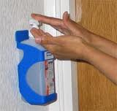

Slide 33
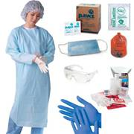
PPE
Gloves
Gowns
Caps
Shoe covers
Masks
Respirators
Goggles
Face shields

Slide 34
Ebola virus as HCAI agent

Slide 35
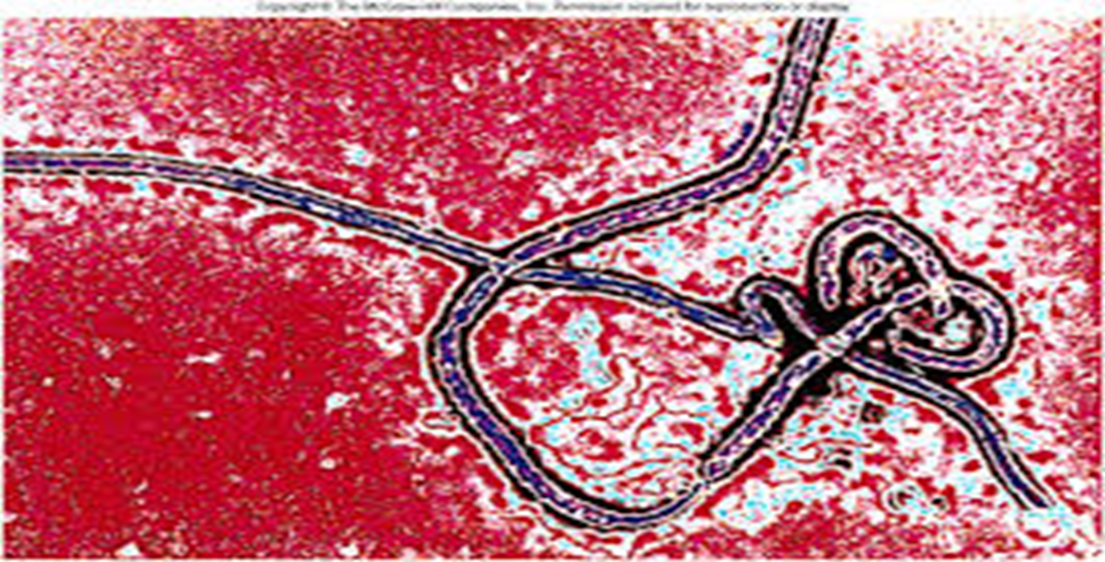
The Ebola virus
The Monster

Slide 36
EBOLA
PRECAUTION
CARELESSNESS
DEADLY ILLNESS
(VHF)
GREAT
WISDOM

Slide 37
previous outbreaks of evd

Slide 38
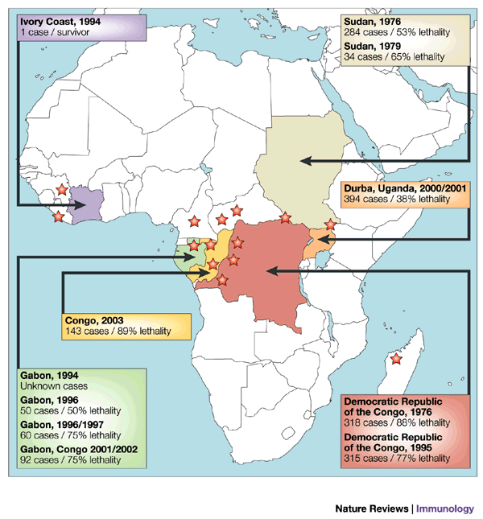

Slide 39
Current outbreak of evd: situation report

Slide 40
February, 2014

Slide 41
Total Number of Ebola cases and deaths per country (http://www.cdc.gov/vhf/ebola/outbreaks/2014-west-africa/case-counts.html) NOV 11
COUNTRY | CASES | DEATHS
NIGERIA | 20 | 8
LIBERIA | 6, 878 | 2,812
SIERRIA LEONE | 5, 586 | 1, 187
GUINEA | 1, 919 | 1, 166
MALI | 4 | 3
SENEGAL | 1 | 0
SPAIN | 1 | 0
US | 4 | 1

Slide 42
Cumulative deaths- up to 11 November (http://www.bbc.com/news/world-africa-28755033)

Slide 43
CFR (as of 11TH NOVEMBER)
COUNTRY | NUMBER OF CASES | NUMBER OF DEATHS | CFR (%)
GUINEA | 1, 919 | 1, 166 | 60.8
SIERRIA LEONE | 5, 586 | 1, 187 | 21.2
LIBERIA | 6, 878 | 2, 812 | 40.9
NIGERIA | 20 | 8 | 40.0
MALI | 4 | 3 | 75.0
SENEGAL | 1 | 0 | 0.0
TOTAL | 14, 408 | 5, 17 | 35.9

Slide 44
Number of Ebola cases and deaths reported in healthcare workers in West Africa-ECDPC, Oct. 2014 (http://ec.europa.eu/health/preparedness_response/docs/ebola_riskassessment_en.pdf)
COUNTRY | No of HCW Infected(%) | No of Dead HCW (%)
Guinea | 76 (5.2) | 40 (4.7)
Liberia | 209 (4.9) | 96 (3.9)
Sierra Leone | 129 (4.0) | 95 (8.0)
Nigeria | 11 (55.0) | 5 (62.5)
Total | 425 (4.7) | 236 (6.0)

Slide 45
TRANSMISSION OF EBOLA VIRUS

Slide 46
TRANSMISSION OF EBOLA VIRUS
CONTACT mainly
1. ANIMALS–HUMAN:
Bodily fluids of infected animals: blood, urine, faeces, other secretions
Organs and other parts of the Body of infected animals
2. HUMAN-HUMAN:
Direct: (through broken skin or mucous membranes) Bodily fluids of infected people: blood, urine faeces, saliva, sweat, semen, vaginal secretions, other secretions, organs or other body parts
Semen (Ebola virus present in semen, even 7 weeks after recovery from illness)
Vaginal Secretions????????????
Indirect: (contaminated environments/ items)
Burial ceremonies & Sites

Slide 47
TRANSMISSION OF EBOLA VIRUS
Nosocomial transmission
Contact - Direct & Indirect
Laboratory Air borne transmission (Aerosol generation)

Slide 48
NOSOCOMIAL TRANSMISSION
Contact with contaminated Hospital Equipment
Contact with Infected tissues, Bodily fluids, hospital wastes
CONTACT with Infected Patients

Slide 49
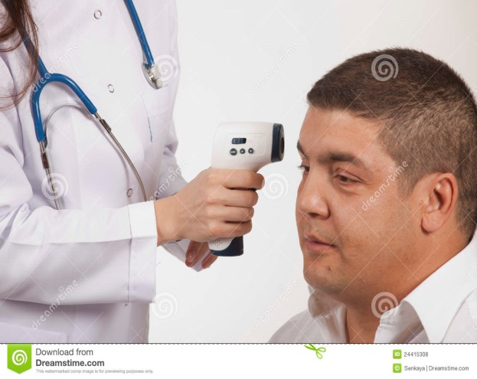
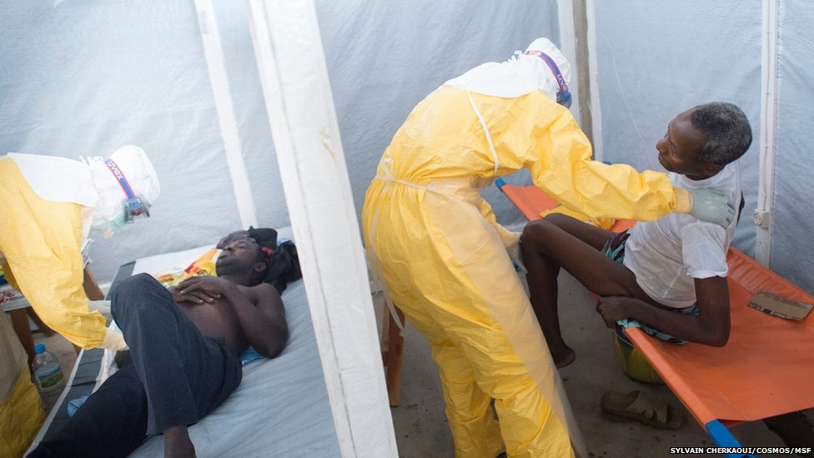
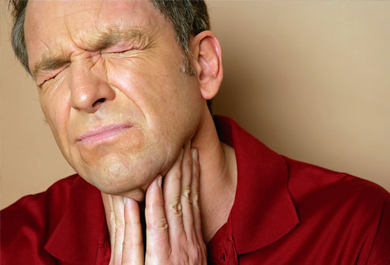
Early SYMPTOMS
Fever of Sudden onset
Intense weakness
Muscle pain
Headache
Sore throat
Notes:
Nosocomial transmission(spread of a disease within a health-care setting,
Non disposabel needles or syringes:they, or may not have been sterilized, but only rinsed before reinsertion into multi-use vials of medicine.
lack of protective clothing
contact with contaminated objects
improper sterilization of medical equipment

Slide 50
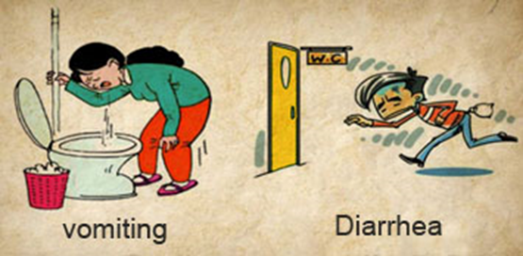
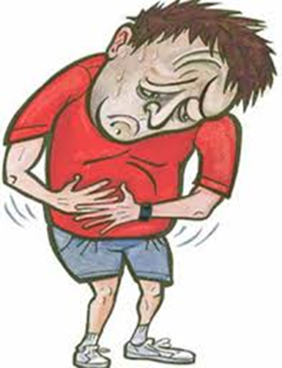
SYMPTOMS: Later Acute symptoms
Vomiting & Diarrhoea
Abdominal pain

Slide 51
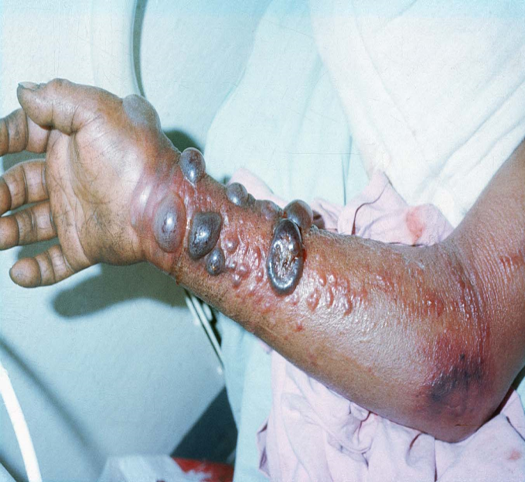
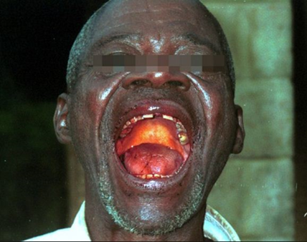
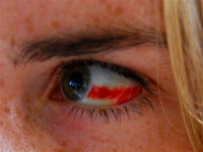
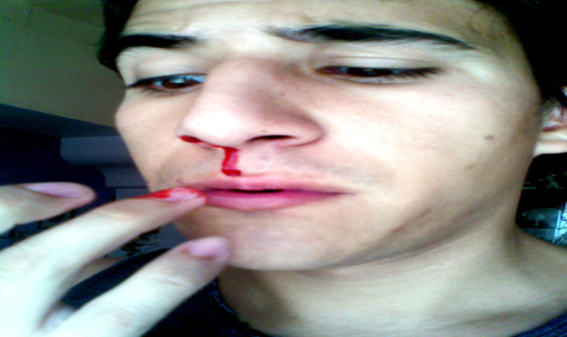
SYMPTOMS: Later Acute symptoms
Bleeding
red eyes
skin rash
Bleeding from skin
Mouth bleeding or vomiting blood,
Bloody stool
Bloody urine
Nose & ear bleeding
…INDICATIVE OF NEG PROGNOSIS.

Slide 52
DIAGNOSIS

Slide 53
CLINICAL DIAGNOSIS
Watch for Symptoms
Most important clinical indicator is Medical history
History of travel
Occupational history
Exposure to wildlife
Exposure to infected patients

Slide 54
CASE DEFINITION for clinic use
PERSON UNDER INVESTIGATION:
No s/s, positive history of travel or contact
SUSPECTED CASE :
s/s plus history of travel or contact
PROBABLE CASE:
s/s plus history of contact with death of the contact
CONFIRMED CASE:
after lab diagnosis

Slide 55
DIFFERENTIAL DIAGNOSIS
Malaria
Typhoid fever
Shigellosis
Cholera
Meningitis
Hepatitis
Other VHFs… LASSA FEVER, MARBURG, CONGO-CRIMEAN

Slide 56
Definitive LAB. DIAGNOSIS of evd
Categories of tests for definitive diagnosis
A. Electron microscopy
B. ELISA
(1). Antigen capture
(2). Antibody capture (IgM, IgG)
B. Serum neutralization tests
C. Immunohistochemistry testing
D. Viral isolation by culture
E. PCR (RT-PCR)

Slide 57
Definitive LABORATORY DIAGNOSIS of evd Http://Www.Cdc.Gov/Vhf/Ebola/Diagnosis/Index.Html
TIMELINE OF INFECTION | DIAGNOSTIC TESTS AVAILABLE
Within a few days after symptoms begin | Antigen-capture enzyme-linked immunosorbent assay (ELISA) testing IgM ELISA Polymerase chain reaction (PCR) Virus isolation/ culture
Later in disease course or after recovery | IgM and IgG antibodies assay
Retrospectively in deceased patients | Immunohistochemistry testing PCR Virus isolation/ culture

Slide 58
TREATMENT
NO CURE !!!!!!!!!

Slide 59
Prevention: vaccination
NO VACCINE!!!!!!!!

Slide 60
Prevention: Containment
TRAINING & RE-TRAINING
SAFETY precaution
PPE
Proper handling & disposal (wastes & corpse)
Sterilization & Disinfection
Hand hygiene
hand washing
hand sanitizing
ISOLATION precaution (Isolation, Quarantine, Contact tracing)

Slide 61
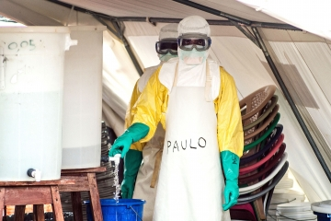
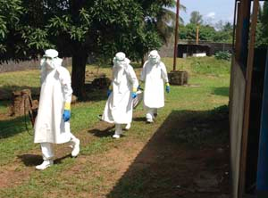
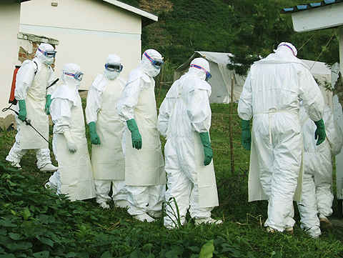
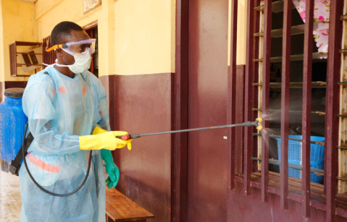
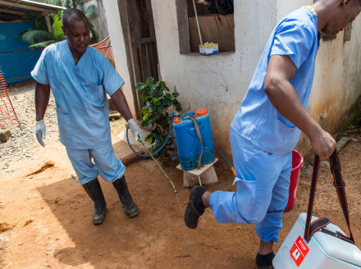
PPE (waterproof)
Gloves
Gowns
Caps
Shoe covers
Masks
Respirators
Goggles
Face shields

Slide 62
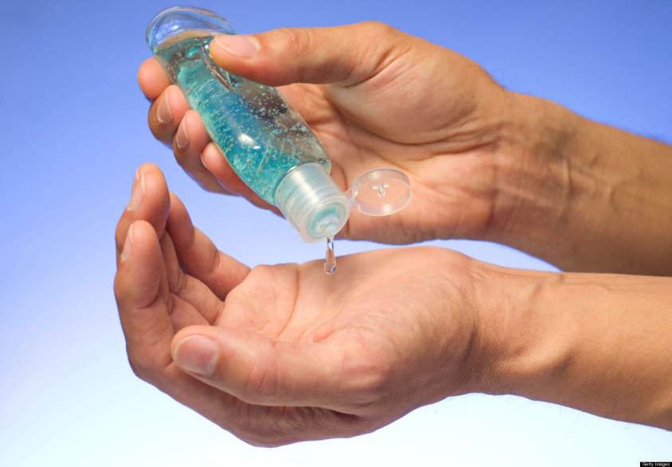
Hand hygiene & precautions?

Slide 63
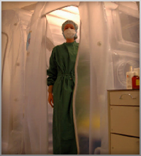
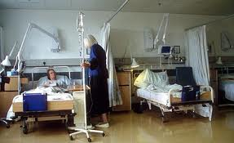
Isolation precaution: Isolators in open wards?

Slide 64
Institutional consideration
Ebola Response Committee
Strategic framework
Surveillance
Ebola Rapid Response Team
Triaging
SOP
Checklist
Collaborations
Containment
Health Care Giver’s Safety
PPE
Training

Slide 65
conclusion
HCAI
COMPLEX!
CONTRIBUTORY TO HUMAN MORBIDITY & MORTALITY!
CONTROL CAPITAL INTENSIVE!!
&
Dependent on HCW’s
KNOWLEDGE
PERCEPTION &
ATTITUDE !!!

Slide 66
Thank you!
Nagode!
E se gan ni!
Daalu!

