Slide 1
Infection Control Clinical Pharmacy and Patient Safety
Pharm Onyekachi Estelle Mbadiwe,
Mpharm, MSc

Slide 2
Summary
Clinical Pharmacy
Clinical Pharmacy & Infection Control
Infection Control Committee
Antimicrobial Stewardship
Practical Tips
Take Home Messages

Slide 3
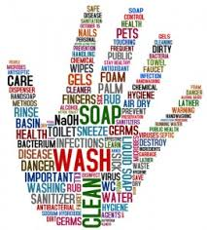
Infection Control

Slide 4
Key Definitions
Infection Control—The process by which health care facilities develop and implement specific policies and procedures to prevent the spread of infections among health care staff and patients
Nosocomial Infection—An infection contracted by a patient or staff member while in a hospital or health care facility (and not present or incubating on admission). Also called healthcare associated infections (HCAI)

Slide 5
Clinical Pharmacy
Definition:
The area of pharmacy concerned with the science and practice of rational medication use.
The term “clinical” does not necessarily imply an activity implemented in a hospital setting.
It includes all the services performed by pharmacists practising in hospitals, community pharmacies, nursing homes, home-based care services, clinics and any other setting where medicines are prescribed and used.
Huge potential to improve patient’s outcomes but unfortunately its not yet mainstay in a lot of Nigerian healthcare establishments.

Slide 6
Infection Control Role of Pharmacist
Multi-disciplinary team working
Report to the Infection control committees and antimicrobial stewardship
Multidisciplinary infectious diseases patient reviews
Audits on antimicrobial use
Hospital sterilisation and disinfection advice
Rational use of antibiotic therapy

Slide 7
Break the chain of Infection
Pathogen, source, mode, entry, susceptible host
Break The Chain of Infection

Slide 8
Infection Control Committee
Who makes up the team ?
Hospital Management
Microbiologist (usually chairperson)
Lead Nurse
Clinician Representative from major clinical specialties
Pharmacist
Housekeeping / Maintenance

Slide 9
Infection Control Committee
Goal: Prevent spread of infectious diseases
Policies and Procedures
Specialist Infection Prevention and Control advice.
Manage outbreaks of infection.
Education and training
Advise on issues relating to new buildings or refurbishment works.
Link with external agencies.

Slide 10
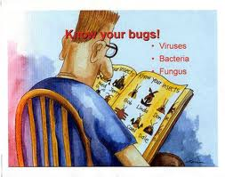
Antimicrobial Stewardship Team
“Core members of the team include an infectious diseases physician, a clinical pharmacist with infectious diseases training, a clinical microbiologist, an infection control professional, and hospital epidemiologist being optimal”
Notes:
The Infectious Diseases Society of America (IDSA) has also recognized the value of the pharmacist’s expertise and recommends the inclusion of these healthcare professionals on antibiotic stewardship teams.6 The guidelines note

Slide 11
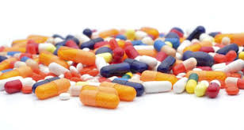
Antimicrobial Stewardship Goal
Primary goal
To optimize clinical out- comes while minimizing unintended consequences of antimicrobial use, including toxicity, the selection of pathogenic organisms and the emergence of resistance.

Slide 12
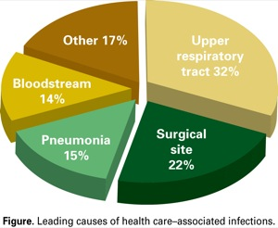
Health Care Associated Infections

Slide 15
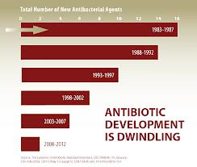

Slide 17
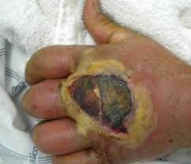
“Antibiotic Resistance - Bigger Crisis Than AIDS. Death From Minor Scratch a Possibility” WHO

Slide 18
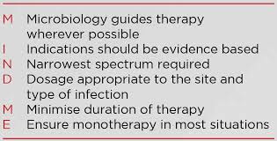

Slide 19
Pharmacist’s Role In Antimicrobial Stewardship
Reducing the transmission of infections,
Promoting the rational use of antimicrobial agents
Educating health professionals, patients, and the public.

Slide 20
1. Reducing the Transmission of Infections.
Selection and use of appropriate antiseptics, disinfectants, and sterilants.
Internal pharmacy policies, procedures, and quality control programs
Developing guidelines for risk assessment, treatment, and monitoring of patients and health care workers who have been in contact with persons with a transmissible infectious disease.
Recommending policies for the frequency of changing ventilator tubing and other noninvasive patient devices that may serve as sources of infection.

Slide 21
2. Promoting Rational Use of Antimicrobial Agents
Minimizing the development of resistant strains of micro-organisms
Antibiotic therapy guidance
– Choice of drug – Dosing, Step-down therapy
Restricted antimicrobial-use procedures, therapeutic interchange and clinical care plans.
Working with the microbiology laboratory to ensure appropriate microbial susceptibility tests

Slide 22
3. Educational Activities.
Educating health professionals, patients, and members of the public
Antimicrobial use and resistance, decontaminating agents (disinfectants, antiseptics, and sterilants), aseptic technique and procedures, and sterilization methods.
Counseling on adherence to prescribed antimicrobials
Public health education campaigns

Slide 23
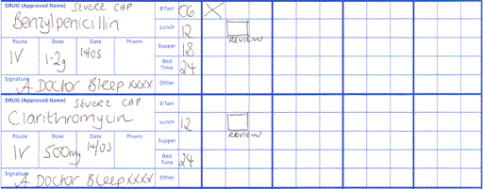
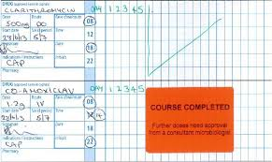
Antimicrobial Stewardship Practical Tips

Slide 25
Antimicrobials with Excellent Oral Bioavailability
Fluconazole (>90%)
Moxifloxacin (~90%)
Ciprofloxacin (70‐80%)
Clindamycin (~90%)
Metronidazole (>95%)

Slide 26
Hand washing

Slide 27
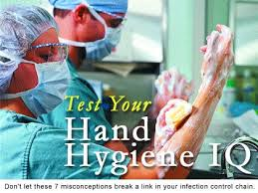

Slide 28
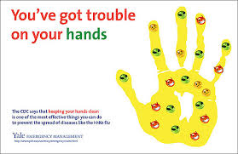
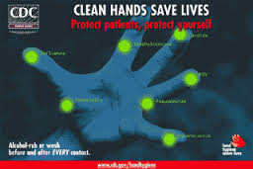
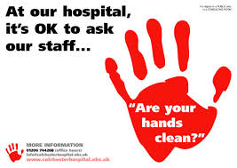
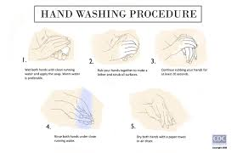

Slide 29
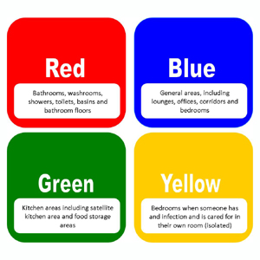
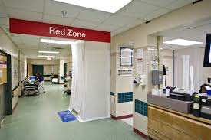
Colour Zones– Practical Tips

Slide 30
Take Home Messages
Clinical Pharmacy
Set up / review infection control committee
Antimicrobial stewardship
Review processes and procedures
Colour code infection control zones
Staff training
Benchmark then audit staff and procedures
Infection control week
Infection control champions
Notes:
Universal protection, cleaning

Slide 31
Thank You

