Slide 1
Surgical safety & hospital acquired infections
Dr Jimi Coker
Chief of Surgery
Lagoon Hospitals, Lagos

Slide 2
Overview
Define Hospital Associated Infections
Surgical site infection (SSI)
Wound classification
Risk stratification of SSI
Care bundles
Antibiotic prophylaxis
WHO Safety check list
SSI surveillance
Summary

Slide 3
Hospital Acquired Infection
Nosocomial infection
Infections occurring more than 48 hours after hospital admission
Evidence of poor quality health service delivery
Avoidable cost
  Increased ALOS
  Further interventions
  Delayed return to work

Slide 4
Hospital Acquired Infections relating to surgery
Surgical site infections
Urinary Tract Infection (CAUTI)
Indwelling Catheter/cannula Infection
Ventilated Associated Pneumonia

Slide 5
Hospital Acquired Infections relating to surgery
Surgical site infections
Urinary Tract Infection (CAUTI)
Indwelling Catheter/cannula Infection
Ventilated Associated Pneumonia

Slide 6
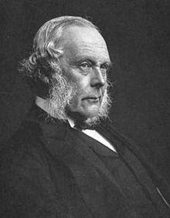
Joseph Lister (1827 – 1912)
1883-1897
British surgeon at GRI
Used Carbolic Acid (Phenol) to clean hands, instruments and wipe on surgical wounds
Drastically decreased infections.

Slide 7
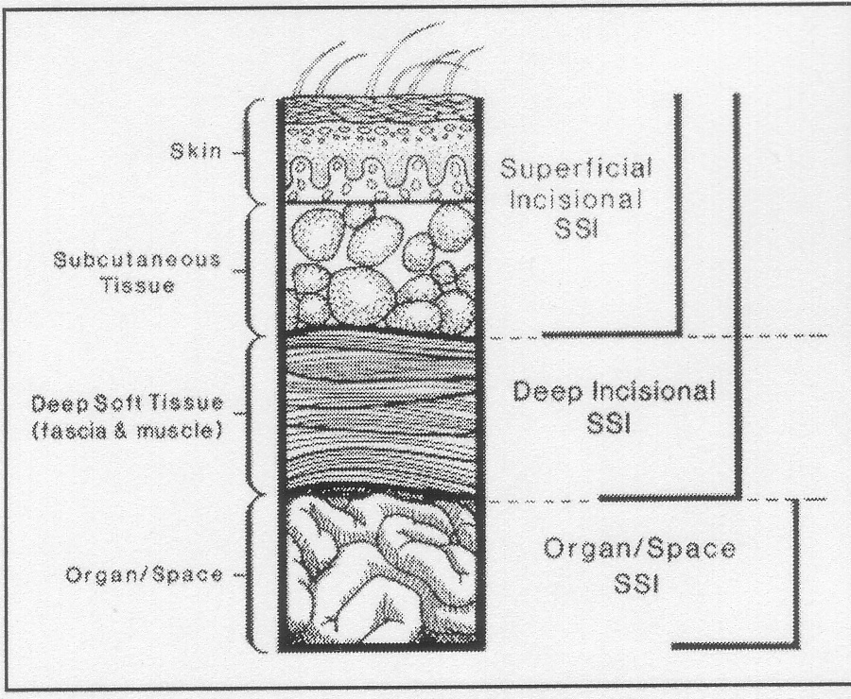
Surgical Site Infections (SSI)
Purulent discharge, abscess or spreading cellulitis at surgical site up to one month after surgery.
3rd most common hospital infection
Incidence : 0.5 – 15%
Incisional
  Superficial
  Deep
Organ Space
  Generalized (peritonitis)
  Abscess

Slide 8
SSI transmission
Exogenous
  Surgeons, nurses and other staff
  Medical equipment
  Other patients
Endogenous
  Skin flora
  Other infections in patient
  Blood transfusion (rare)

Slide 9
SSI – Wound Classification
Class 1 = Clean
Class 2 = Clean contaminated
Class 3 = Contaminated
Class 4 = Dirty infected
Prophylactic antibiotics indicated
Therapeutic antibiotics
Mangram AJ et al. Infect Control Hosp Epidemiol. 1999;20:250-278.
Notes:
Surgical site infections are categorized into four classes depending on wound type. Class 1 is a clean wound, class 2 is a clean contaminated wound, class 3 is a contaminated wound, and class 4 is a dirty infected wound.

Slide 10
Types of Surgery
Clean | Hernia repair breast biopsy | 1.5%
Clean-Contaminated | Cholecystectomy Elective bowel resection | 2-5%
Contaminated | Emergency bowel resection | 5-30%
Dirty/infected | Perforation, abscess | 5-30%

Slide 11
SSI – Risk Stratification NNIS Project
Independent variables associated with SSI risk
  Contaminated or dirty/infected wound classification
  ASA > 2
  Length of operation > 75th percentile of the specific operation being performed
NNIS=National Nosocomial Infections Surveillance.
NNIS. CDC. Am J Infect Control. 2001;29:404-421.
Notes:
Three independent variables have been shown to be associated with surgical skin infection risk through the National Nosocomial Infections Study.
These include an ASA greater than 2, classification of the wound as contaminated or dirty, and length of operation being longer than the 75th percentile of the specific operation being performed.

Slide 12
Host Risk Factors
Diabetes mellitus
Hypoxaemia
Hypothermia
Leukopenia
Nicotine (tobacco smoking)
Immunosuppression
Malnutrition
Poor skin hygiene

Slide 13
Perioperative Risk Factors
Operative site shaving
Breaks in operative sterile technique
Improper antimicrobial prophylaxis
Prolonged hypotension
Contaminated operating room
Poor wound care postoperatively
Hyperglycemia
Wound closure technique

Slide 14
Operative Antibiotic Prophylaxis
Decreases bacterial counts at surgical site
Given within 60 minutes prior to starting surgery (knife to skin)
Repeat dose for longer surgery (T 1/2)
Do not continue beyond 24 hours
Determinants – prevailing pathogens, antibiotic resistance, type of surgery
Not a substitute for aseptic surgery or good technique

Slide 15
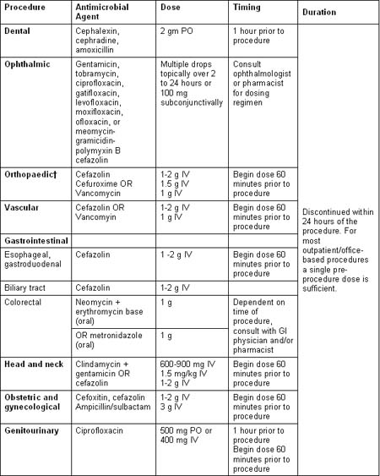

Slide 16
Preop
Scrub
  Duration? With what?
Skin preparation
  Iodophors, chlorahexadine, or alcohol
Hair removal
  Night before? Clipper vs razor
Antiseptic showering
  Reduce skin flora only

Slide 17
Care bundle:
A grouping of best practices that individually improve care, but when applied together result in substantially greater improvement.
Science behind the bundle elements is well established – the standard of care.
Bundle element compliance can be measured as “ yes/no” for audit

Slide 18
Surgical Site Infection Prevention Bundle Components
1. Prophylactic antibiotic given within one hour prior to surgical incision
2. Appropriate prophylactic antibiotic selection for surgical patients
3. Prophylactic antibiotics discontinued within 24 hours after surgery end time (48 hours for cardiac surgery)
4. Cardiac surgery patients with controlled 6 A.M. postoperative serum blood glucose

Slide 19
Surgical Site Infection Prevention Bundle Components
Surgery patients with appropriate hair removal
Surgery Patients with Perioperative Temperature Management – maintaining normothermia
7. Urinary Catheter removal on postoperative Day 1 or 2 with day of surgery being day zero.

Slide 20
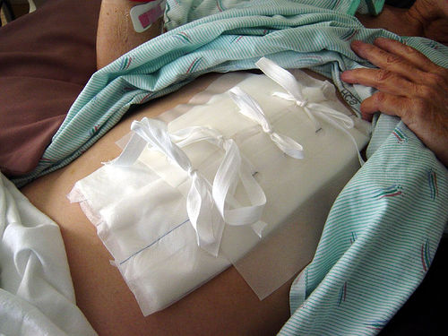
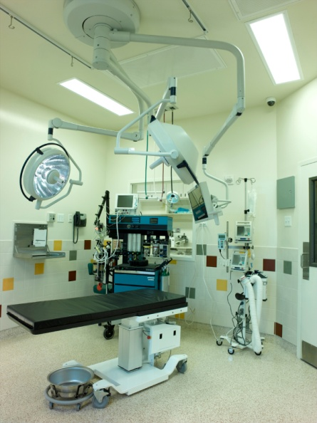
Other SSI Prevention Measures*
Protect closed incision with sterile
dressing for 24-48 hours
postoperatively
Maintain adequate/recommended
ventilation processes in the
operating rooms
*CDC Guideline for Prevention of Surgical Site Infections, 1999

Slide 21
Timing of prophylaxis
Intravenous antibiotics should be given within 60 minutes before skin incision and as close to time of incision as practically possible
(N Engl J Med 1992;326:281-6 & Ann Surg 2008;247:918 - 926)
For caesarian section it can be given pre-incision or after cord clamping
Single dose with long-enough half-life to achieve activity for duration of operation

Slide 22

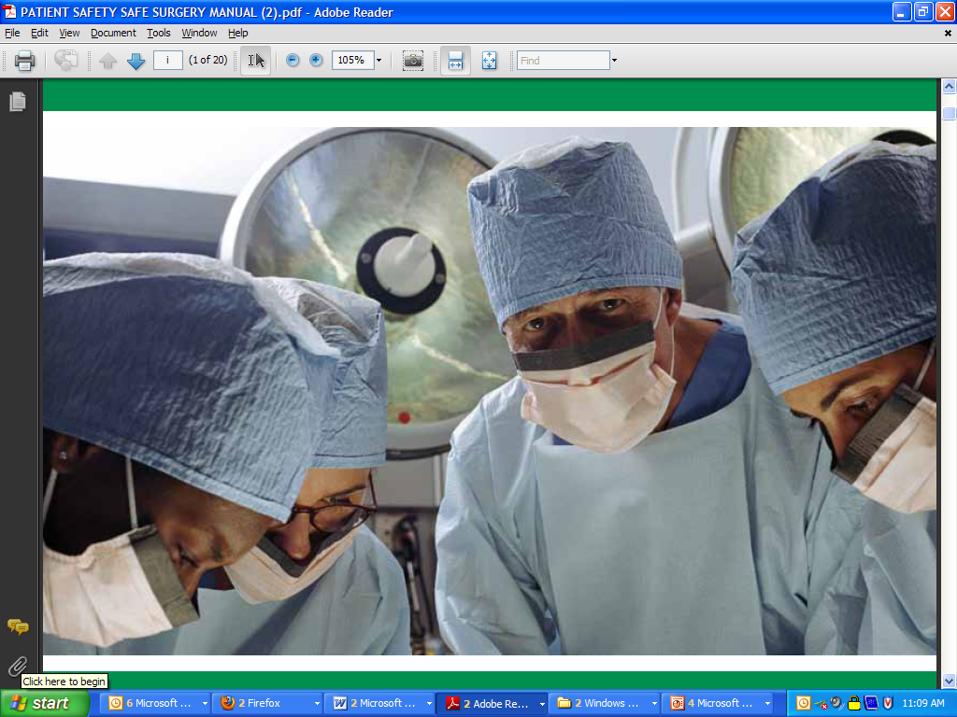
Safe Surgery Saves Lives
Notes:
22

Slide 23
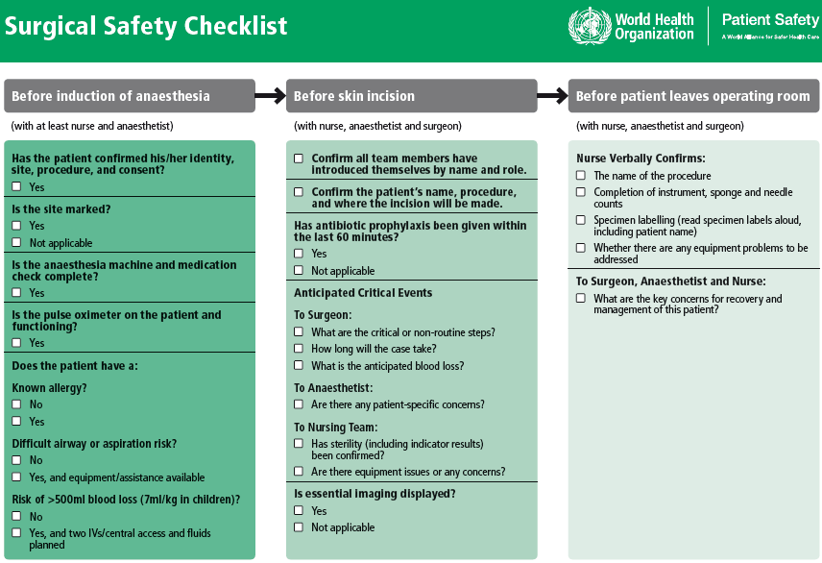

Slide 24
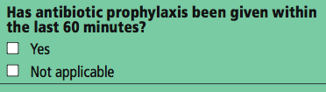

What problems does this checklist address?
Minimizing risk of infection
  Giving antibiotics within one hour before incision can cut the risk of surgical site infection by 50%¹, ²
  In the eight evaluation sites, failure to give antibiotics on time occurred in almost one half of surgical patients who would otherwise benefit from timely administration
Before skin incision:
¹ Bratzler, The American Journal of Surgery, 2005.
² Classen, New England Journal of Medicine, 1992.

Slide 25
Results – All Sites
 | Baseline | Checklist | P value
Cases | 3733 | 3955 | -
Death | 1.5% | 0.8% | 0.003
Any Complication | 11.0% | 7.0% | <0.001
SSI | 6.2% | 3.4% | <0.001
Unplanned Reoperation | 2.4% | 1.8% | 0.047
Haynes et al. A Surgical Safety Checklist to Reduce Morbidity and Mortality in a Global Population. New England Journal of Medicine 360:491-9. (2009)

Slide 26
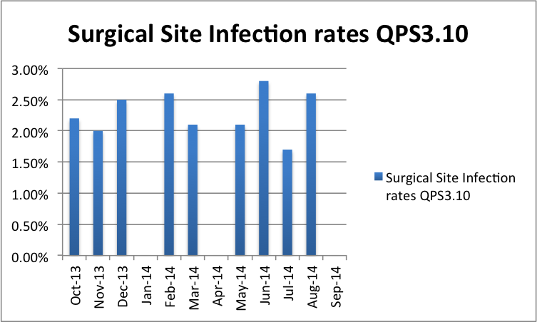
SSI surveillance at Lagoon Hospitals

Slide 27
Summary
SSI is a major problem in surgical patients
Significant morbidity/mortality and expense
Prophylactic antibiotics, ASA grade and timely surgery important risk factors
WHO Safety checklist proven all over the world – highly recommended
Importance of SSI surveillance in hospitals
Safe surgery saves lives!

