Slide 1
Structuring An effective Risk Management & Root Cause Analysis
R. I Akintola
FWACS

Slide 2
INTRODUCTION
Risk Management : IDENTIFICATION,ANALYSIS, & EVALUATION of risk and the selection of the most advantageous method of treating it.(ASHRM)
Focus
Components of an effective Risk Management Process
Root Cause Analysis

Slide 3
WHY
There is an increasing awareness in our society of patient rights, malpractice litigation trends, and heightened expectations about patient safety.
All healthcare providers must therefore focus on enhancing the effectiveness of their risk management programs.
Those who fail to do so will find themselves exposed to greater risk for failing to implement appropriate patient safety protections.

Slide 4
Risk - DEFINITIONS
Risk
The chance of something happening or a hazard being realised that will have an impact upon objectives. It is measured in terms of consequences and likelihood Standards Australia (1999)
Risk in healthcare
The likelihood of harm that somebody or something will be harmed by a hazard, multiplied by the severity of the potential harm. DOH (2000) An Organisation with a Memory.
Risk Assessment
The overall process of risk analysis and risk evaluation Standards Australia (1999) Risk Management
Risk Management
The culture, processes and structures that are directed towards the effective management of potential opportunities and adverse effects Standards Australia (1999) Risk Management
Risk Management in healthcare
Clinical and administrative activities undertaken to identify, evaluate and reduce risk of injury to patients, staff and visitors and the risk of loss of the organisation itself. Joint Commission on Accreditation of Healthcare Organisations (2000

Slide 5
What Is Risk Management?
Identifying, Accessing, Preventing, & Monitoring situations that could result in:
■ Injury or liability,
■ Financial loss,
■ Regulatory noncompliance.
Risk management should be a common thread throughout the entire organization.
All are to be involved (employee & volunteer)
Designated Focal Point for integration
Risk manager/Quality manager/Compliance manager.

Slide 6
KEY POINTS
Decisions : Take into account potential risks that could directly or indirectly affect patient care.
Risks:
Inherent in all aspects of healthcare,
Properly assessed, can help health organizations, set their priorities & improve decision-making to reach an optimal balance of risk, benefit & cost.
Clinical, Environmental, Financial, Political, & Reputational.
For each hazard identified it is important to decide if it is significant & whether appropriate & sufficient controls or contingencies are in place to ensure that the risk is effectively minimized

Slide 7
Risk Management Program Elements
Depending on the setting, a comprehensive and effective risk management program should include the following elements:
Safety/security programs.
Occupational Safety and Health Administration (OSHA)employee health program.
Clinical Laboratory Services.
Infection control.
Patient& Family rights .
Informed Consent procedures.
Clinical standard of care/negligence.
Service accessibility.
Medical waste disposal.

Slide 8
Medical record documentation.
Confidentiality policy and standards for release of medical information.
Mandatory reporting requirements.
Licensure requirements.
Accreditation standards.
Credentialing/privileging guidelines.
Contract management.
Monitoring of marketing/public relations/external representations.
Complaint/grievance management.
Employment practices guidelines.

Slide 9
Construction/physical plant requirements, permits, etc.
Regulatory compliance activities.
Professional Indemnity Issues.
Retention of insurance policies.

Slide 10
Risk Management Process
Why, How ,When, Who
Identify Services
Assessment
Analyze
Develop & deploy mitigating measures
Monitor & Evaluate
CQIP

Slide 11
Risk Management program HOW
1.Leadership Support (Empowerment)
■ Describes the risk manager position & authority
2.Identify team (Multi Disciplinary Team)
NB; Hallmark of Success
Consistent & thorough processes .
Commitment
Regular reviews & updates

Slide 12
3.Review organization’s policies & procedures
Ensure
Consistent with the standard of care delivered in the facility /practice
Reflect actual operations/practices.
Maintain historical archives of policies & procedures.
Schedule reviews/revisions/updates as necessary.
Confirm appropriate signatures with effective dates and revision dates.
Delete/repeal unused or incorrect policies or procedures

Slide 13
4.Exposure identification mechanisms.
Formal reports (incident, errors , near-misses.
Formal review of:
Prior claims.
Patient complaints.
Employee complaints.
Standardized surveys/questionnaires.
Inspections/surveys/audits/consultants or expert reviews.
Quality assurance reports.

Slide 14
5.A formal & standardized incident reporting process that:
Defines:
What “incidents” must be reported.
What form to use.
When a report needs to be completed.
Who completes the report.
What needs to be reported (reportable events) & to whom.
Who does the follow-up investigation.
Utilizes available legal protections for confidentiality and disclosure
Management medico-legal issues

Slide 15
6.An incident follow-up process that addressees:
Who does the investigation?
What was the outcome?
What needs to be done to avoid the problem in the future?
Documentation.
7. A tracking/trending process for:
Incidents.
Claims and lawsuits.
Specified indicators (may be quality assurance indicators)

Slide 16
8.Staff training/education that:
Position/Job-specific.
Involves new-employee orientation, as well as periodic training. &Continuous Professional Dev
Uses both internal and external training.
Documents all training.

Slide 17
Full interaction with the following groups:
Quality Assurance Committee.
Safety Committee.
Clinical Committee.
Administrative Committee.
Corporate Compliance.
Board of Directors.
May seem overwhelming, but can be accomplished with organizational commitment.

Slide 18
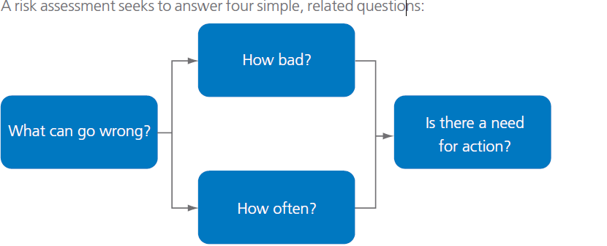
Risk Assessment Process: An integrated approach that can be used as an improvement tool

Slide 19
Why -Benefits of risk Assessment
Improve work & the care delivered
Focuses on reduction / mitigation of risk
Compliance with Standards for Better Healthcare
Better decision-making through a solid understanding of all risks & their likely impact;
Plan for uncertainty & cope with impact of unexpected events
Increase staff, patient & public confidence in the service
Highlights the weakness and vulnerability in procedures, practices and policy changes

Slide 20
When
At various stages
Early
During detailed design
Modification
Time –vary according to magnitude & complexity of the service or the changes

Slide 21
Who
Staff for which risk is relevant
Parties affected by risks (clients & public)
Roles & responsibility
The risk assessor
Multi- disciplinary team (MDT) clinical and non-clinical participants
The recorder
Ownership is key
Feed risk into Risk register
Focal point( designated individual to ensure follow up & close out

Slide 22
How
Participants do not need to have past risk assessment experience to contribute.
The approach does, however require a MDT service, or treatment.
Group facilitation skills is required

Slide 23
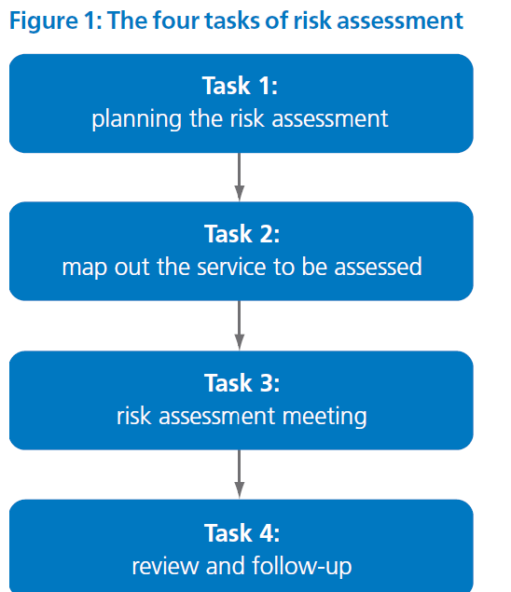

Slide 24
Estimating probability. Subjective.
NB
Memorable events seem more common
Constant feedback necessary to ensure accuracy
Incident data, literature & other sources are useful.
Effectiveness of estimated potential impact for prevented incidents.
Potential to over- or under-estimate the possible impact of an incident, ( element of bias)

Slide 25
Balance of analysis.
Don’t focus exclusively on the most serious incidents or risks
Lessons can be learned from low to moderate incidents or risks even near misses which occur more frequently.
Resources.
Ensure policies and approach match the capacity to act.

Slide 26
Step 2 Map the Services
Mapping out the activities,
Patient booking or treatment;
identifying interactions with all component parts;
identifying other changes resulting from your proposed service or treatment;
changes in the activities of others should be included in the activities’ map and be risk assessed;
collecting relevant documents including protocols, care escalation policies and patient
information leaflets.

Slide 27
Sub-task
Develop initial prompts: ‘what if’ questions
Develop record sheet
Obtain risk matrix

Slide 28
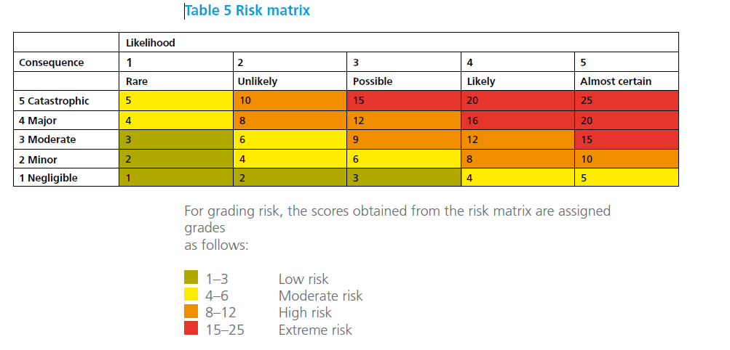
Risk Matrix

Slide 29
Task 4: review and follow-up
Address outcome of risk assessment according to the organization's risk management policy and procedures.
Review the recommendations from the assessment meeting, and agree whether to implement them as they stand or to modify
Agree on method of implementation
Open a register for the identified hazards & remediation actions. Identify action parties.
Agree actions with relevant parties

Slide 30
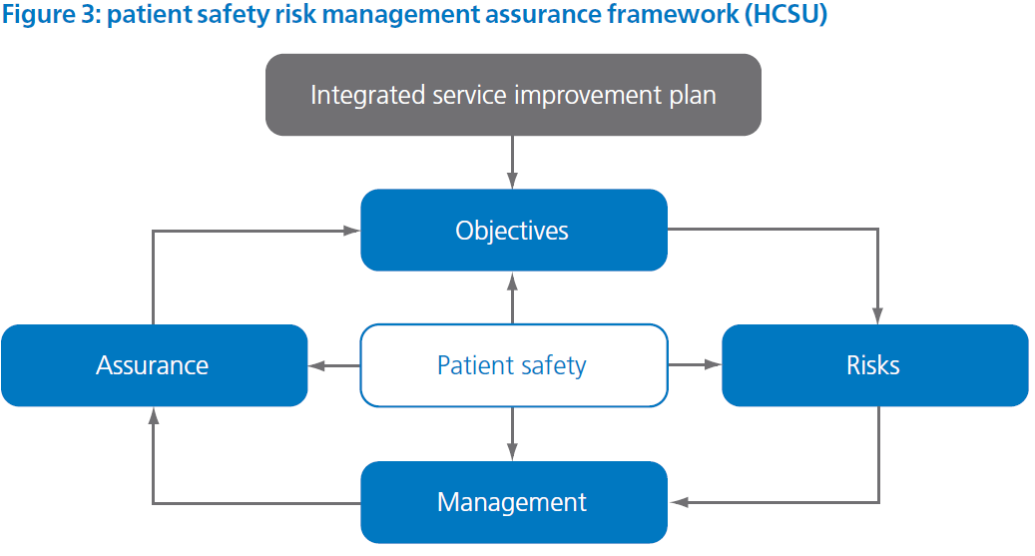

Slide 31
Objective: the assessor identifies the key purposes and achievements for the organization, service or treatment.
Risks: the systematic identification and assessment of risks affecting the organization, service or treatment.
Management: controls for assuring that the identified risks are mitigated through targeted recommendations and/or solutions.
Assurance: evidence of assurance, for example audit, patient safety incident (PSI) reporting, investigation and analysis via significant event auditing or other systematic methods.

Slide 32
Other Actions
Identified risk to pt safety & assess when proposing a new or different service or patient pathway.
Implement & maintain appropriate control measures.
Assure that risk mgt controls are effective

Slide 33
Risk Assessment Models
FMEA
HFMEA
HACCP
HAZOP
BARRIER ANALYSIS & DEVELOPMENT

Slide 34
Types of barriers
1 Physical barriers: an actual physical hindrance
2 Natural barriers: barriers of distance, time or placement
3 Human action barriers
4 Administrative barriers

Slide 35
Identify the service
Does the basic design provide appropriate safe care
Does the service or pt pathway provide safe care
When there is a change/modification how safe is it?
Develop ‘what if’ questions

Slide 36
Root Cause Analysis
Tool for identifying prevention strategies. A process that is part of an effort to build a culture of safety and move beyond the culture of blame
Developed by JCI to investigate & analyze healthcare incidents
An intensive process with origins in ‘total quality mgt’
? Need to find out root cause of an adverse incident tracing it back over a series of events to some fundamental problem
* RCA –is to use the incident to reveal gaps and inadequacies in the healthcare system
Goal is to find out what happened why did it happen and what to do to prevent it from happening again

Slide 37
Analysis of Clinical Events
Adverse events/incidents are usually preceded by unsafe acts.
For better understanding its necessary to look further, back to the “error producing conditions” that led to the unsafe acts and to “latent failures” or the decisions made by management and others which may have had a bearing on the outcome

Slide 38
Investigation Process
Sources of information
Case notes,
Statements from witnesses
Other relevant documents
Establish sequence of events
Interview people involved to establish sequence of events***
contributory factors & care mgt problems as perceived by each staff
Involved Patient & family members??
*Interviews should include: What happened, How did it happen ,why did it happen

Slide 39
Investigation Process
Identify obvious problems
Recommend corrective actions
ID action party
Timeline for close out
Careful mgt of family & patient
(emotional & physical injury). Support as required
Caregivers to be honest
Believe & show empathy
Ensure continuity of care
Avoid blame culture. “Second victim syndrome “
Encourage openness
Share learning points.
Systems analyses and support for pts and staff should be absolute priority in any risk mgt and safety strategy

Slide 40
Care management problems identified :
actions/omissions of healthcare staff
Clinical context of each of these problems:
Salient clinical events or condition of the of the patient
Other patient related factors that may have affected the process
Contributory Factors to their occurrence:
Conditions in which errors may occur within the overall organizational context

Slide 41
Lack of knowledge/skills & experience
Task: Non availability of test results or protocols
Team: Inadequate supervision, poor communication among staff
Work environment; Heavy work load, inadequate staff, limited access to vital equipment.

Slide 42
Latent Conditions
Latent Failure
Contributory factors / Associated Factors
Root Causes / Causal Factors
Lessons Learned
Recommendation

Slide 43
Conclusion
For an effective Risk Management Process
Identify the need
Obtain management support
Set up a team
Identify service elements
Review or develop policies/protocols/ procedures
Conduct risk assessment
Identify risks
Open a Risk register and reporting process
Process for investigating risk RCA
Develop mitigating plan- barriers
Put Q A process in place
Continuous Quality Improvement Process

Slide 44
Thank You

Slide 45
Definitions
Patient safety freedom from unnecessary or potential harm
Patient Safety Incident Any unintended or unexpected incident which could have or did lead to harm for one or more patients receiving NHS funded care.
Unsafe Act :An act or omission, which is taken outside policy or procedure, which increases the risks of injury, failure or adverse outcomes.
Hazard : A situation with a potential to cause harm
Sentinel Event A Sentinel Event is defined by The Joint Commission (TJC) as any unanticipated event in a healthcare setting resulting in death or serious physical or psychological injury to a patient or patients, not related to the natural course of the patient's illness.

