Slide 1
‘When things go wrong’
Dr Efunbo Dosekun
CEO- Outreach Hospital Group
10/12/15

Slide 2
Synonyms
When things go wrong
Harm –an unintended event

Slide 3
Harm vs Error in healthcare
Harm
Medical harm
Non medical harm

Slide 4
Definition
Harmful incident- unintended harm resulting in death, disability, injury ,longer hospital stay
No harm incident-incident occurred but did not harm the patient
Near miss-an incident almost occurred but did not reach the patient

Slide 5
Definition of Disclosure
Open communication in an honest manner when things go wrong with health care delivery

Slide 6
Difference b/t incident process + Disclosure process
Harm
Incident
Internal team
Disclosure
Patient/Caregivers

Slide 7
Questions for discussion
How do I decide whether to tell a patient about an error?
Do physicians have an ethical duty to disclose information about a medical error?
Would disclosing make patients undermine their trust in the physician and the medical system?
By disclosing a mistake to my patient , do I risk having a malpractice suit filed against me?
What if I see someone else make a mistake?

Slide 8
Stages of disclosure
Initial Disclosure
Immediate
May involve several meetings
Post analysis
After investigation

Slide 9
Circumstances when disclosure can take place- Initial Disclosure
Analysis of event
Harm from progression of disease
Health Associated event
Harm from recognized risk-inv. +RX
Healthcare provider led
Leadership participate or would provide advice
Patient safety incident
Different combination can occur

Slide 10
Stages of Disclosure
Initial Disclosure
HCP lead
Management support/may be several meetings
Post analysis disclosure
Management led
HCP may be involved

Slide 12
Apology
Apology
Sincerity
Words
Non verbal behavior-gestures, facial expression, tone/pitch/pace of voice
Not an admission of legal liability
Acknowledgement after investigation

Slide 13
When to disclose
Patient safety incident
Harmful incident
Always disclose
No harm incident
Usually not disclose
Near Miss

Slide 14
Post Analysis
Management led
Healthcare Provider may be present
Legal representation
Patient informed on improvement so it does not happen again
Acknowledgement of representation

Slide 15
Consequences of Medical Error
Resolution
Civil Liability
Criminal Liability
Professional Liability
Organizational retailation

Slide 16
Old Proverbs still hold good
To err is human, to forgive divine Alexander Pope 1688-1744
Justifying a fault doubles it-A French proverb

Slide 17
To Err is human-Instituite of Medicine 1999
Adverse events in 1 in 25 to 1 in 30 of hospitalised cases in USA
1 In 9 to 1 in 12 die
50% 0f adverse deaths preventable
44,000-98,000 die each year

Slide 18
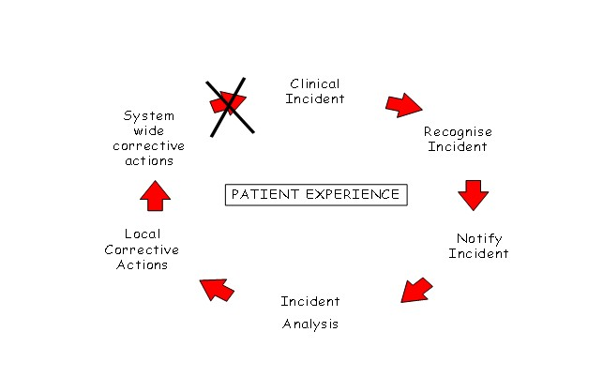

Slide 19
Causation of patient safety incident
Provider performance
System Failure

Slide 20
Optimal provider performance
Clinical Knowledge
Communication skills
Assertiveness
Interpersonal skills
ICT skills
Procedural Skills

Slide 21
Problem in Medical Performance
Active Error
Negligence
Human Error

Slide 22
Code of Conduct-MDCN
Failure to give prompt attention to a patient
Manifest incompetence in clinical assessment
Wrong diagnosis in presence of obvious clinical presentation
Fails to advice on risk attendant to conditions or intervention
Makes glaring mistakes
By action or omission makes other members of the health team to cause harm

Slide 23
Medical Negligence
In the Nigerian case of Diamond Bank Ltd v Partnership Investmentco Ltd, 32 the Supreme Court of Nigeria defined negligence thus: “(Negligence is generally defined as the failure to exercise the standard of care that a reasonable prudent person would have exercised in a similar situation; any conduct that falls below the legal standard established to protect others against unreasonable risk of harm..” per Ogbuagu JSC pp 52-53” Negligence is a question of fact and each case depend upon its own perculair facts and circumstances. Babalola Abegunde AJHSS Vol1-3,Nov 2013

Slide 24
Medical Negligence
Medical negligence law covers the consequences for medical practitioner’s non-exercise of appropriate care and rights of patients when a medical practitioner makes an error or fails to provide an acceptable level of care in the execution of his duty. This is called “fault liability”. Negligence has been defined by Baron Alderson in the case of Blyth v Birmingham Water Works as: “ the omission to do something which a reasonable man would do or doing something which a reasonable or prudent man would not do.”34. Babalola Abegunde AJHSS Vol1-3,Nov 2013

Slide 25
Negligence
Registrar of British Colombia 2004
Only 1% of complaints rose to the level of disciplinary action.
Virtually all those actions were related to conduct violation. In the past 12yrs no case has come to discipline on grounds of medical errors alone
Seland 2004

Slide 26
Mistakes in medical practice
 | ERROR | EXAMPLE
1 | Diagnosis or evaluation | Missed Diagnosis
2 | Medical Decision making | Inappropriate premature discharge
3 | Treatment | Delay in Treatment
4 | Medication | Wrong dosage or drug/expired drug
5 | Inadequate supervision | Failure to review plan
6 | Faulty Communication | Poor intrateam communication/poor patient communication
7 | Procedural competence | Faulty technique

Slide 27
MANY RISKS TO PATIENTS
Patient falls
Unsafe use of medical equipment
incorrect handover
Misdiagnosis
Unsafe interface: equipment + providers
Unsafe injections
Unsafe blood
Health care-associated infection
Unsafe surgery
Unsafe use of medication
Poor test
follow-up
Poor training of health care staff
Counterfeit
drugs
Workload
pressures
Stress and fatigue of health care staff
WHO Patient Safety Workshop

Slide 28
Common causes of medical mistakes -1
Poor communication
Poor organisational skills
Ignorance
Hesitation
Fatigue

Slide 29
Common causes of medical errors-2
Inexperience
Juggling too many balls
Lack of assertiveness
Forgetfulness
Faulty judgment

Slide 30
Error Prevention
 | Error Prevention | Examples
1 | Reduce reliance on memory | Checklists, proforma, Intergrated care pathway/Early warning system
2 | Hands off process | SBAR/Hand over instruction
3 | Error proofing system | Fail safe to avoid prescribing 2 drugs that interact
4 | Improved information access | Electronic patient recording
5 | Standardisation | Guidelines, Algorithms, protocols(EBM)
6 | Training on process mapping/Induction | Staff in service
7 | Documentation/Signing | Detailed notes/informed consent
8 | Training on error identification/prevention | Staff in service

Slide 31
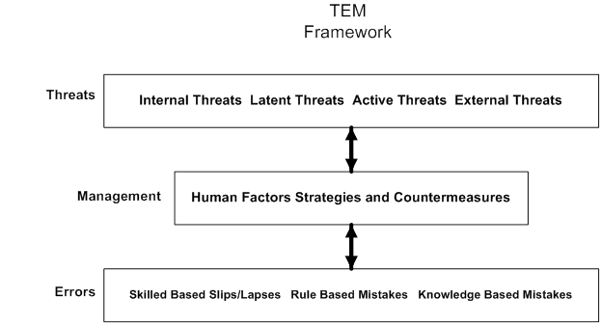
Threat and Error Management

Slide 32
Acknowledge

Slide 35
Prevention is better than cure
Open disclosure begins with informed consent and honest discussion of realistic expectation

Slide 36
System Errors
Equipment Failure
Facility design
Training process
Maintenance culture
Financial resources
Human resource problems
Poor process mapping

Slide 37
Prevention of Medical Errors
Clinical Risk Management Strategy
Patient centered care
Independent Accreditation
Quality improvement strategy
Clinical governance
Hospital Safety Program

Slide 38
Clinical Risk Management Strategy
Identify
Assess Frequency & Severity
Reduce or Eliminate
Assess the Cost or Impact

Slide 39
7 Pillars of Clinical Governance
Clinical effectiveness
Risk management
Patient experience
Communication effectiveness
Strategic effectiveness
Learning effectiveness
Resource effectiveness
Notes:
You will often see the 7 pillars of clinical governance expressed in some form of temple effect.
Consider each of the following and decide whether you think they impact on you -
Clinical Effectiveness - systems awareness
Risk Management - teamwork and keeping your eyes and minds open
Patient experience - teamwork, don’t be afraid of working with the public – they are not always against us.
Communication effectiveness - communication
Strategic effectiveness - ownership
Learning effectiveness - ownership, understanding that we are always learning and that we often don’t know the full picture – go back to the stained glass window, we need other pieces to make sense of it all.
I also believe that the NHS is so huge now that we cannot be expert in every field
Resource effectiveness - leadership good leadership will improve the working environment if you are a manager, it is
your responsibility to ensure CG is incorporated into your area.
These are joined by the patient – professional partnership
The patients are not going to go away.

Slide 40
Drivers for Quality-1

Slide 41
Prerequiste to Safety
Attitude
Safety management System

Slide 42
Lessons from high risk industries
High safety culture
Nuclear
Aviation
Oil and gas

Slide 43
High Reliability Organisation
Is defined as an organisation which has fewer than normal accidents. This occurs through culture change. It expects it’s organisation and sub-system will fail and works very hard to avoid failure while preparing for the inevitable so they can minimize the impact of failure

Slide 44
“Mindfulness”: involves interpretative work directed
“The key difference between HROs and other organizations in managing the unexpected often occurs at the earliest stages, when the unexpected may give off only weak signals of trouble. The overwhelming tendency is to respond to weak signals with a weak response. Mindfulness preserves the capability to see the significant meaning of weak signals and to give strong responses to weak signals”
Weick and Sutcliffe, 2001

Slide 45
5 Principles of HRO-Dr Weick +Sutcliffe
Preoccupation with failure
Reluctance to oversimplify reason for problems
Sensitivity to operations
Commitment to resilience
Deference to expertise

Slide 46
Implementation of Safety Program - 1
Develop a safety culture
Leadership engagement
Develop champions /identify stakeholders
Community involvement and education
Incident reporting cycle development

Slide 47
Implementation of a Safety Programme -2
Celebrating safety
Safety Video development
Developing an organisation with a memory
Training-formal, simulation,CPD, Education
Occupational Health System
Environmental Safety System

Slide 48
Safety Culture
Calculative
Imposed.Driven by SMS
.Much data collection
Proactive
Work on problems discovered.Workforce move the initiative from top down approach
Generative
Active participation of all.
Inherent part of
business
Pathological
Who cares once we are not caught
Reactive-Safety is imp..We do a lot when an accident occurs

Slide 49
How to make Safety it work in Nigeria
Promotion of statutory duty for quality
National patient safety agency
NICE
Professional self regulation -MDCN
Patient safety program.
New accountability structure
Statutory body for Monitoring Standards
Performance Framework.
Patient Survey.

Slide 50
How to improve the Disclosure process in Nigeria’s Health System
Inclusion in National Health Bill
Development of Hospital Policy/ guidelines on Disclosure by experts/patients support stakeholders inclusion
Medical Defence-hospital/professional
Professional regulation
More Education for all
Development of a National Safety Institute

Slide 51
References
Code of Conduct-MDCN 1990
Development of a National Guideline for disclosure of adverse event-Canadian Patient Safety Institute 2006
HRO Weick and Sutcliffe 2001
Medical Error: the second victim. BMJ 320 (7237):726

