Slide 1
Appropriate use of ppe
Dr Oluseyi Adesola

Slide 2
Learning Objectives
At the end of this lecture participants will be able to:
Recognize circumstances which call for the use of PPE in order to prevent patient and health care worker contact with potentially infectious material.
Identify specific PPE which is used to protect patients and health care workers from exposure to infectious pathogens.

Slide 3
What is PPE?
PPE refers to specialized clothing and equipment worn by health care providers for protection against hazards.
There is a wide variety of PPE available to HCWs.
The selection of PPE for use in a specific situation is based upon the amount of contact the provider will have with the patient’s body fluids and/or mucous membranes.

Slide 4
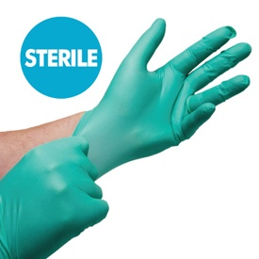
Gloves (1)
What types of gloves are available?
Sterile gloves – used for performing procedures which involve direct contact with sterile body parts (surgical operations). The use of sterile gloves is required in order to reduce the risk of infection transmission to the patient.

Slide 5
Gloves (2)
Non-sterile gloves – used for performing procedures which may require contact with the patient’s body fluids, mucous membranes on non-intact skin. Non-sterile utility gloves should be used when decontaminating patient care equipment, when cleaning the patient care environment or when removing medical waste.

Slide 6
Gloves (3)
Most gloves for use in the health care setting are made of latex.
Some gloves are made of vinyl or a similar polymer.
Utility gloves are generally made of rubber.
Nitrile gloves are specifically designed for handling wet instruments which are disinfected with glutaraldehyde solution.

Slide 7
Latex and Vinyl Gloves
Latex Gloves
Vinyl Gloves

Slide 8
Utility Rubber Gloves

Slide 9
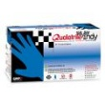
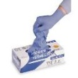
Nitrile Gloves

Slide 10
Gloves (4)
HCW should be aware that gloves made of certain materials may cause allergic reactions.
If HCWs or patients are allergic to latex, hypo-allergenic gloves should be used instead.
HCWs who are allergic to powder should use powderless gloves.

Slide 11
Powdered and non-powdered gloves
Powdered
Non-powdered

Slide 12
When should gloves be worn? (1)
When there is a potential for contact with a patient’s body fluid, mucous membrane or non-intact skin.
When performing blood-drawing procedures.
When handling items contaminated with potentially infectious body fluids.

Slide 13
When should gloves be worn? (2)
Gloves should be removed as soon as a procedure is completed and hand hygiene should be performed following glove removal.
Gloves should always be changed before beginning a procedure on the next patient.
If there is a risk of contact with large quantities of body fluid, two pairs of gloves (double gloving) should be used for additional protection.

Slide 14
Donning Gloves (1)
Pick up the cuff of the first glove with your left hand.
Slide your right hand into the glove until you have a snug fit over the thumb joint and knuckles.
Slide your right fingertips into the folded cuff of the left glove.
Pull out the glove and fit your right hand into it.
Unfold the cuffs down over your gown sleeves.

Slide 15
Donning Gloves (2)
Step1
Step 2
Step 3

Slide 16
Glove Removal (1)
Take hold of the first glove at the wrist.
Fold it over and peel it back, turning it inside out as it goes.
Once the glove if off, hold it with your gloved hand.
To remove the other glove, place your bare fingers inside the cuff without touching the glove exterior.
Peel the glove off from the inside, turning it inside out as it goes.
Use it to envelope the other glove.

Slide 17
Glove Removal (2)
Step 1
Step 2
Step 3

Slide 18
Glove Hygiene
Gloves should not be worn unnecessarily for long periods of time.
Doing so will increase the HCWs risk of infection as the moist skin inside the gloves creates an environment that is conducive to the growth of bacteria.
Disposable gloves may develop small imperceptible holes through which pathogenic organisms may pass.

Slide 19
Cover Garbs
Cover garb include the following garments:
Gowns
Aprons
Laboratory coats
The choice of appropriate cover garb should be based upon the characteristics of the garments.

Slide 20
Types of Cover Garb
Cover garb is available in three varieties:
Impervious garments – generally reinforced for additional protection, fluid will not soak through to the skin.
Fluid resistant garments – provide protection against contact with moderate amounts of body fluids.
Permeable garments – provide protection against contact with small amounts of fluids or small splashes.

Slide 21
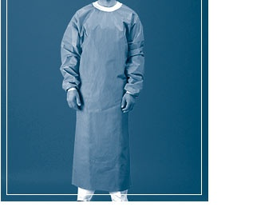
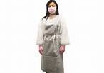
Impervious garments

Slide 22
Fluid Resistant Garments

Slide 23
Permeable garments

Slide 24
When should cover garb be worn (1)
Cover garb should be used whenever there is a risk that arms, legs or clothing will become contaminated with a patient’s body fluid.
An impervious gown should be used in situations where there may be exposure to large quantities of body fluids.
An impervious gown should be worn in the operating room or while providing emergency care to severe trauma patients.

Slide 25
When should cover garb be worn (2)
A fluid resistant gown should be used in situation where there may be exposure to lesser quantities of body fluids.
A fluid resistant gown should be worn when removing soiled linen from a bed or when performing procedures which may generate significant aerosol fluid spray.

Slide 26
When should cover garb be worn (3)
Laboratory coats can be used in situations where only minimal exposure to body fluids is likely.
A laboratory coat can be worn when processing laboratory specimens or drawing blood.
Sterile gowns are used when sterile procedures are performed.
Sterile gowns must be worn in order to reduce the risk of infection transmission to the patient.

Slide 27
Removing Cover Garb

Slide 28
Face Masks
Masks available for use by health care providers are classified as follows:
Non-surgical (Procedure) mask – fluid resistant and have the capacity for relatively high filtration of pathogenic organisms.
Surgical mask – lightweight and generally not fluid resistant.
Particulate respirators – HEPA filtration masks which can screen out particles less than 5 microns in size.

Slide 29
Non-surgical masks

Slide 30
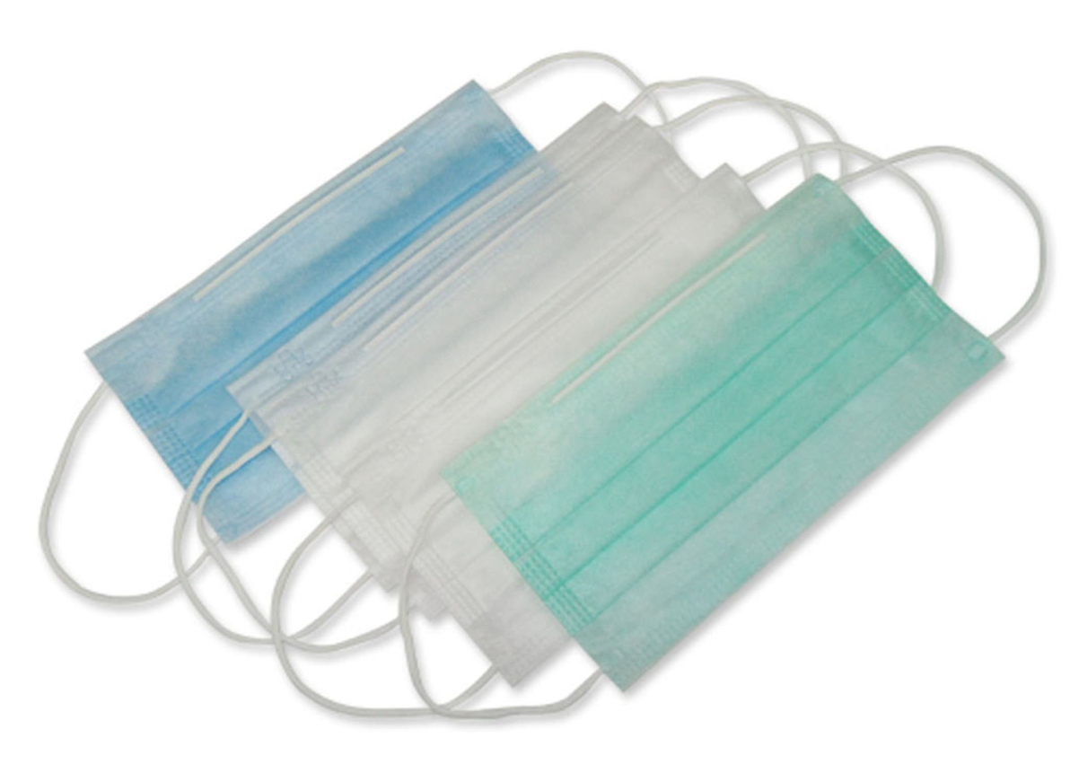
Surgical masks

Slide 31
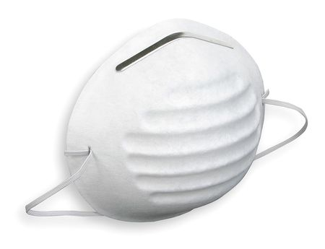
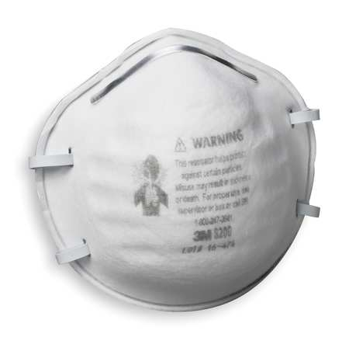
N95 Respirators (1)

Slide 32
N95 Respirators (2)

Slide 33
When should masks be worn?
Masks can provide two types of protection:
Respiratory protection – masks can protect the HCW from inhaling pathogenic organisms.
Barrier protection – masks can protect the mucus membranes of the mouth and nose from direct contact with a patient’s body fluids that may become airborne as a result of accidental splashes or aerosols.

Slide 34
Procedure masks
Should be worn whenever there is a risk of facial contamination with a patient’s body fluid.
Facial contamination may occur during the performance of any procedure which generates sprays or aerosols (dental procedures).
Procedure masks have a relatively high capacity for filtering most pathogenic organisms.
They will provide respiratory protection for the HCW who is caring for a patient with infection which may be transmitted by infectious droplets.

Slide 35
Surgical masks
Lightweight but generally not fluid-resistant.
Some surgeons prefer to use surgical masks in lieu of procedure masks because they are more comfortable to wear over extended periods of time.

Slide 36
Particulate respirator (1)
Mandated under the regulations for use by all HCWs who enter rooms which house patients with known or suspected pulmonary tuberculosis.
Also recommended for HCWs caring for patients with known or suspected smallpox infection (if an outbreak should occur) and when caring for patients with known or suspected SARs or Avian Influenza A.

Slide 37
Particulate respirator (2)
This type of facial protection is officially classified as a “respirator” because it creates an air tight seal on the user’s face and provides HEPA filtration of inhaled air.
Because of the “respirator” designation, there are specific rules and regulations that govern the use of these devices.
Standard regulations require that HCWs be medically cleared, be provided with specialized training, and be tested for appropriate facial fit before they may use a particulate respirator for the first time..

Slide 38
Goggles and Face Shields
Eye protection is often overlooked by many HCWs.
Important to remember that infectious pathogens can enter the body through the eyes just as they can enter the body through the mucous membranes.
Important to use eye protection when encountering situations in which body fluid splashing may occur.

Slide 39
Goggles
Simple and convenient to use.
They provide greater protection than ordinary eyeglasses.
Designed with side pieces which cover all points of entry to the eyes.
Eyeglasses leave gaps on the sides through which fluids or aerosols may enter.

Slide 40
Face Shields
Provide full facial protection by means of a transparent shield which extends from the forehead to the area below the chin.

Slide 41
Goggles and Face Shields
Goggles
Face shields

Slide 42
Shoe and Head Covers (1)
Shoe covers are recommended for use when performing procedures where the HCW shoes are likely to become grossly contaminated by the patient’s body fluids.
In sterile settings such as operating theatres shoe covers are worn to prevent infection for HCWs shoes to the patient.
In the BSL3 laboratory shoe covers are used to prevent transmission of infection to the HCW to the outside through the person shoes.

Slide 43
Shoe and Head Covers (2)
Head covers protect patients against pathogen transmission from the surgical team member’s hair during the course of an operation.
In the BSL3 head covers are optional but are used to prevent transmission of infection to the HCW.

Slide 44
Considerations for the selection and use of personal protective equipment (1)
Impermeable barriers must be used whenever there is a potential for contact with large quantities of blood or body fluids.
Barriers need not be used in situations where there is only casual patient contact.
Gloves should only be used when there is a potential for contact with body fluids, mucous membranes, non-intact skin or other contaminated items which may transmit infection.

Slide 45
Considerations for the selection and use of personal protective equipment (2)
Sterile barriers must be used when performing surgical procedures or invasive procedures.
Barriers should always be changed before beginning work on the next patient.

Slide 46
Recommendations for Donning PPE
Always perform hand hygiene before donning PPE
If wearing a gown, don the gown first and fasten in back accordingly.
If wearing a facemask or respirator don facemask.
If wearing goggles or face shields, put it on face and adjust to fit.
If wearing gloves in combination with other PPE, don gloves last.

Slide 47
Recommendations for Removing PPE
Remove PPE before leaving the exam room or patient environment (except respirators which should be removed after exiting the room).
Remove gloves
Remove gowns
Remove goggles and face shields
Remove face masks or respirators
Always perform hand hygiene immediately after removing PPE.

Slide 48
Summary
Various types of PPE and barrier equipment are available for use by HCWs.
If correctly used PPE and barrier equipment will prevent HCWs from exposure to TB bacilli.

Slide 49
Questions

