Slide 1
PATIENT REPORTED OUTCOMES TO INFORM HEALTH AND SAFETY
EDUCATING PATIENTS ON THEIR CARE
DISCHARGE PROCESS.
BY
ABISOLA AUDIFFEREN

Slide 2
OVERVIEW
What are Patient Reported Outcomes (PRO)?
Why educate the Patient?
Who should educate the Patient?
Improvement Cycle.
Process of Education.
Assessment of PRO.
Impact of PRO on population health.

Slide 3
PRO: DEFINITION
Patient reported outcomes are reports coming directly from the patient about how they feel or function in relation to a health condition without interpretation by health care professionals.
PRO’s can relate to symptoms, functional status, convenience and tolerance.
PRO’s are the validation of effectiveness and quality of medical care.

Slide 4
WHY EDUCATE THE PATIENT?
Patient reported outcomes are an essential measurement, to assess if the care given correlates with overall improved health and well being.
Patients who are engaged have better outcomes due to shared decision making. This allows a concordance between values, preferences and available scientific evidence.
It leads to increased impacts of quality improvement in health care delivery.
To assess the impact of the quality of medical efforts from the patient’s perspective, is based on whether it helps the patient/family, as they see it.

Slide 5
The goal of most health care providers is to improve the patients health and there are data arguing that patients perspective on health is highly relevant and needs to be part of the efforts to improve the well being of the patient.
This is not to say that it is a replacement of clinical measures but a valuable, complimentary and crucial insight on the effects of health care delivery as seen by the patient. Different perspectives need to be acknowledged.

Slide 6
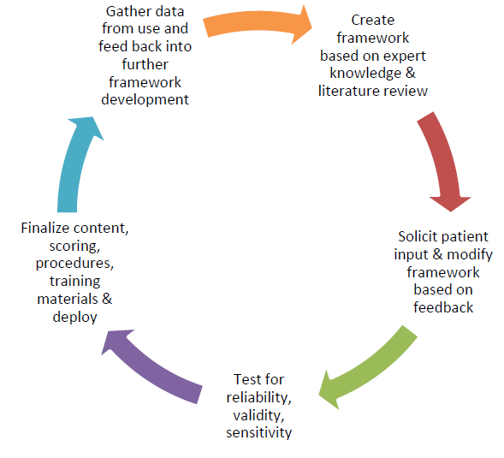
IMPROVEMENT CYCLE

Slide 7
WHO SHOULD EDUCATE
Clinicians
Nurses
Pharmacists
Social Workers
Therapists

Slide 8
WHAT TO EDUCATE
“The fundamental measure of a health system’s performance is its ability to aid patients in recovering from acute illness, live well with chronic conditions and, face death with dignity”.
Life styles modifications.
Compliance with all medical efforts.
Dietary Elements.
Social factors and norms.

Slide 9
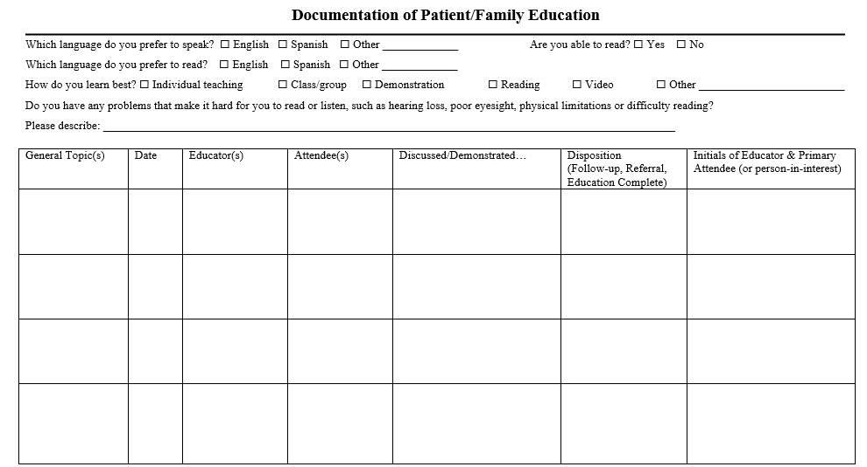

Slide 10
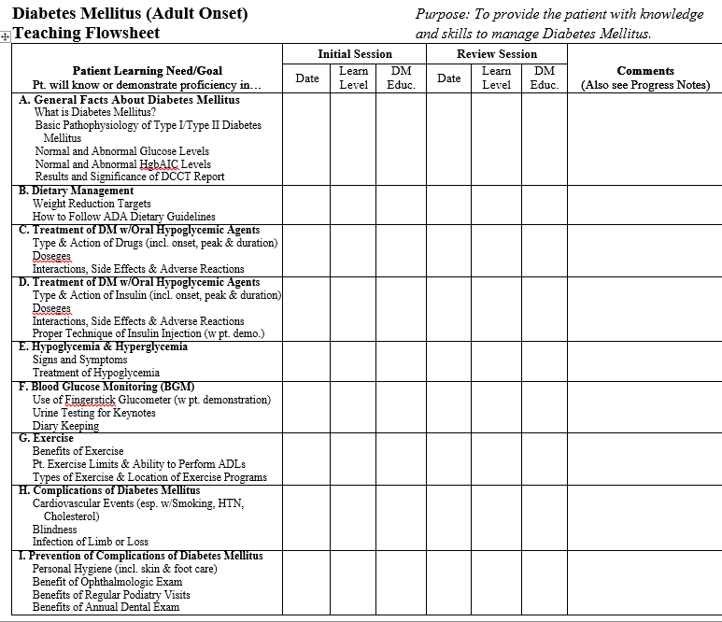

Slide 11
PROCESS OF EDUCATION
An assessment of the patient’s educational level, language barrier socio-cultural factors must be done prior to the informing process. This is may be done by elicitation of relevant questions.
Audio-visual aids such as slides,leaflets,emails etc. will be a good source of informing and educating different classes of patients.
For unaware patients: folklores,plays and translated audios would be a better option. You can not give a low educational level patients reading materials. We must study the values, beliefs and culture of our target population before we can ascertain the right mode to educate them.

Slide 12
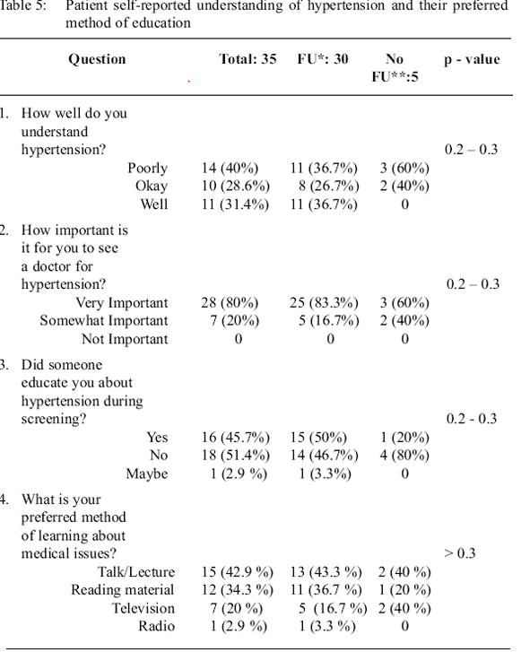

Slide 13
LOW LEVEL LITERACY LEAFLET

Slide 14
HIGH LEVEL LITERACY LEAFLET

Slide 15
TRANSLATING PRO INTO IMPROVEMENT
Before improvement can be monitored, the care-educator must assess the patients understanding of the care-plan; he/she may be asked to repeat or demonstrate all that was discussed in their words.
Key Performance Indicators(KPI) must be established to monitor and track the performance of the patient based on applicable disease criteria.
Diabetes Mellitus KPI’s may include: Waist Circumference
Body Mass Index (BMI)
Hemoglobin A1C(HBA1C)
Fasting Blood Sugar(FBS)
Blood pressure (BP) Control

Slide 16
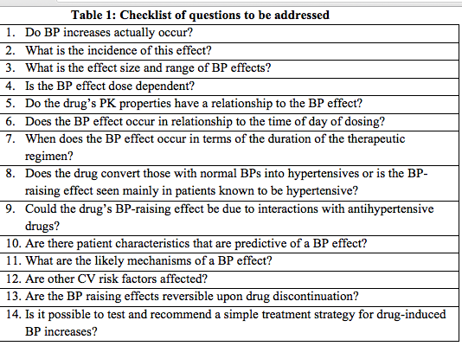

Slide 17
IMPACTS OF PRO. ON POPULATION
PRO’s are used to attain patient-centric care.
To identify strength and weakness in the quality of care and consequent improvement.
Create feedback loops on quality measures through the eyes of the patient and not the provider.
Determination of comparative effectiveness of different treatment plans through shared decision making.
Assessing performance standards in delivering quality health care sector.

Slide 18
OBSTACLES TO IMPROVEMENT OUTCOMES
PRACTICAL FACTORS: The collection of data may be disruptive to normal duties. Manpower must be adequate,resources must be available. Appropriate training of health professionals must be done so as to achieve collaboration. Manual collation may be time-consuming whilst technology which is more efficient is costly.
ATTITUDINAL FACTORS inhibiting the use of PRO’s can be avoided by engaging the health care professionals at the start of the quality improvement process for proper understanding and buy-in. Suspicions can be allayed,motives,aims and objectives can agreed upon form the onset.
Some professionals consider PRO’s as an audit system to measure performance ,punitive measure to ensure compliance whilst some are not open to feedback, that is not clinical.
.

Slide 19
METHODOLOGICAL FACTORS: The mode of assessment and collation of data may vary from provider A to provider B based on structure, manpower etc. The variations (common or special) may affect the overall validity of the data and they should be investigated.
IMPACT FACTORS: There are significant problems in identifying and implementing opportunities for quality improvement. PRO’s have been confused with patient satisfaction surveys and even clinical data

Slide 20
VALIDATION OF PRO
Quality improvement can only occur through proper collation of relevant datasets, appropriate analysis to mitigate variations and quality failures.
Care episodes have to be monitored properly especially in inter-provider comparisons. A study done on Appendectomy patients showed “ little inter-provider variations which did not change over time”. Based on that analysis, it is pertinent that focusing on the patient’s characteristics, provider structure and treatment plan are assessed to explain the outcomes.
PRO’s as a quality improvement tool must be fit for purpose. They must have gold standards of measure.

Slide 22
BEST PRACTISE ON IN-PATIENT CARE
Ward rounds must be done by all participating health providers involved in the treatment episode i.e. Multidisciplinary rounds. Pain, discomfort or well being are discussed with the patient or next of kin. Checklists are used to allow uniformity in the rounds.
Communication leaflets/brochures available in the rooms for ease of informing patients about their rights whilst in the hospital, new /existing medication, discharge goal etc.

Slide 23
Handover reporting by care provider should be done with the patient or next of kin,this will allow for clarification on any existing questions.
Discharge brochure; this contains a list of drugs and dosage, purpose of the medications, symptoms and most importantly contraindications.
A follow-up phone call is done 2 days post-discharge to check on patients well being and answer any lingering question.
Total quality management(Standards of practice) must be inculcated into all processes.

Slide 25
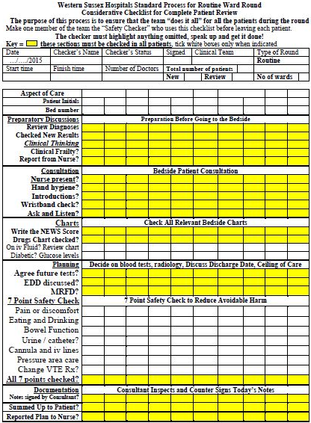

Slide 26
SUMMARY
Patient Reported Outcomes are questionnaires patients complete about their health and quality of life.
Information gathered can be used to monitor individual patient outcomes, adjust treatment plan to suit the patient.
Patient reported outcomes can be Condition specific or Generic.
Improvement is a continuous cycle thus patient-centric care should be embraced.

