Slide 1
Established 1952 ST. NICHOLAS HOSPITAL
National Leaders in Healthcare reform
Mrs Siba Agbeyegbe, LLB, LLM, Solicitor England & Wales , Barrister Nigeria

Slide 2
Who we are
St. Nicholas Hospital (SNH) is a growing privately owned group of hospitals and clinics based in Lagos, Nigeria –established in 1952 the Campbell building was erected in 1968
A full service acute general hospital at Campbell, OPD clinics at Victoria Island, Maryland and Lekki Free Trade Zone
Currently the group has a bed capacity of 49 beds at Campbell office with plans to upgrade the Maryland site to include inpatient bed capacity
The hospital treated 28,688 outpatients and 1,256 inpatients in 2015

Slide 3
Achievements
We are one of the largest privately owned multi-specialist acute hospitals in Nigeria
We provide good primary, secondary and tertiary medical care from our Lagos sites.
St. Nicholas Hospital (SNH) has been at the forefront of medical care since inception and still leads the way.
SNH is the first private hospital to open a renal transplant centre and we have since conducted over 150 transplants in our renal transplant unit, which is 80% of all transplants in Sub-Saharan Africa
We were the first private hospital with an Oncology clinic that focuses on all cancers and complex blood diseases in adults

Slide 4
What is ‘patient experience’?
Its all about prioritising the patient
How do they feel?
Why are they at the facility for treatment?
What do they expect from us?
Do they feel out of control in this environment?

Slide 5
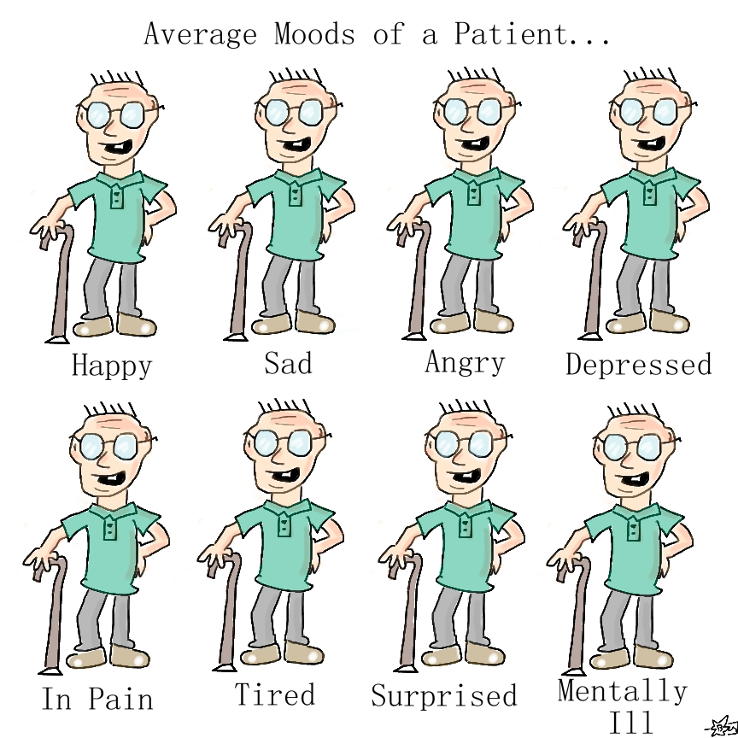

Slide 6
Personal space being invaded
Overwhelmed
Missing family
Worried
Don’t like being told what to do
Upset/Irritated
Have things to do & In a hurry to leave
Vulnerable
Lack of privacy
Feel lost

Slide 7
The patient is now in our environment
Its all about the patient and their patient journey
From the moment the patient comes into the facility to the moment they leave
We have to PRIORITISE the patient
We must respect them
We must treat them with dignity
We must recognise their autonomy and ability to make their own decisions
We must keep them informed of what we are doing to them (take time to explain)
We must identify who we are and what our job is and why we are doing what we are doing to them

Slide 8
A good rule ….
Treat patients the way you would like to be treated in similar circumstances
or
Treat patients as you would treat your friends and family

Slide 9
Patient centred care
First and foremost safe and effective clinical practice
The right treatment at the right time at the right place
Help your organisation to work as a team
Identify any processes that are not necessary and which do not help the patient
Try to keep waiting times to a minimum
Try to work out where the patient has to go to in advance and help them get there through the most direct route
Do not send them from pillar to post – advise all colleagues to be the answer to patient’s enquiries as to where to go next
Take the patient journey into consideration when planning redevelopment, renovation work or new service lines

Slide 10
Take pride in your work
The people who recommend or complain most about your services are your users
take a note from the hospitality sector and ensure patients return time and time again
Be professional at all times – don’t be found gossiping or speaking loudly
Speak to your patients not at them or over them or about them – the patient is present
Ensure the environment is kept clean and remember you are a part of the clean up team no matter how senior you are

Slide 11
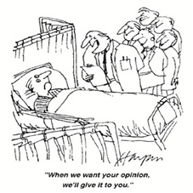
Listen to your patient
Wrong site surgery could have been avoided if the doctor had listened to the patient in the first place

Slide 12
Feedback from patients – complaints, compliments, claims????
All feedback from patients is useful for informing the organisation as to what they are doing right and what they are doing wrong
All healthcare provider facilities should have a complaints management department that responds promptly to patient concerns that they either raise by themselves or which are raised on their behalf by next-of-kin
A complaint that turns into a legal claim is a serious matter that needs to be handled professionally. Often an early apology (which is different to an admission of fault ) can prevent matters turning legal
All feedback should be used by organisations to learn lessons which are cascaded throughout the hospital so that everyone can learn from them and so avoid that error recurring

Slide 13
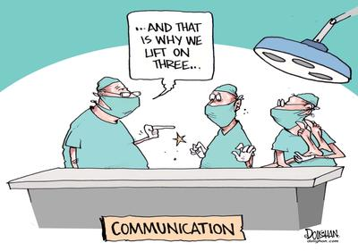
Communicate

Slide 14
Communicate !!!!
Think about what you are doing – failure to communicate with your colleagues can cost a patient their life or their quality of life
Ensure that you do comprehensive handovers
Write your contemporaneous notes
If you promise to do something for your colleague do it – don’t leave them hanging
When we review many of our in-house complaints failure to communicate is a regular theme
It is just as important to communicate from top to bottom in the organisation as it is to communicate laterally
ALWAYS communicate with the patient

Slide 15
Safety First
follow guidelines, policies, procedures and treatment protocols
If you follow the process you are unlikely to be found to be at fault
The process has been introduced because evidence shows that it reduces risk of harm to the patient
Report incidents so that faulty equipment and other failures can be rectified quickly
Double check dispensing to avoid dispensing errors
Reduce rewriting instructions – scan/cut and paste if possible to avoid human error

Slide 16
Be Professional
Complete handover patiently – don’t be in a hurry
Be present when you are scheduled – the roster is very important to safety and staffing ratios
Be clean and tidy in your appearance, be aware of your own odour, don’t offend patients
Keep medical confidences and other matters that a patient may confide in you at their vulnerable time
Respect your colleagues at work and listen to what they have to say – they are doing their job
Speak in English unless you are required to do otherwise – the vernacular is not professional

Slide 17
Maintain Patient Dignity
Uppermost in care giver’s mind
Hospital apparel should protect the patient’s dignity
Ability to do things unaided
Maintain the patient’s identity – they are not suddenly one of many because they are on a ward
Respect modern equality and diversity - the vulnerable patient is not there for you to judge them
Respect the patient’s faith even if it is no faith – again do not judge or prey on the vulnerable – let them invite you to minister if the topic comes up but do not presume you should or that you have the authority to do so

Slide 18
Enjoy your work
Be a shining example of your profession
Some patients can be inspired by the treatment they receive and touched by a good caregiver
Director of Patient Experience – maybe but its everybody's job

Slide 19
What could cause them to give feedback?
How you do your job !!

Slide 20
End
Thank you

